Slide 1

Economic Power
Noah Hacker

Slide 2

Lessons Structure
Economic Power – Basic Terminology
Statesmanship/Economic Influence – key instrument?
State Budget – key instrument
Team Exercise

Slide 3

Power Balance
“Our security does not rely solely on the military. Non-military factors are as crucial as the military: the nation’s financial capability; the competence of the laborers; agricultural produce… stocks of food and raw materials… transportation routes…”
David Ben Gurion, 1953

Slide 4

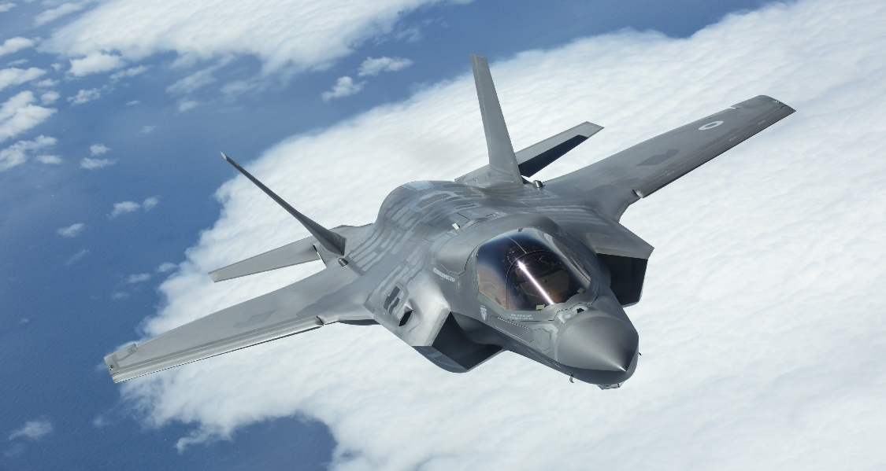
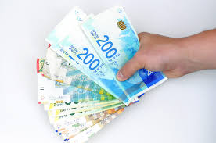
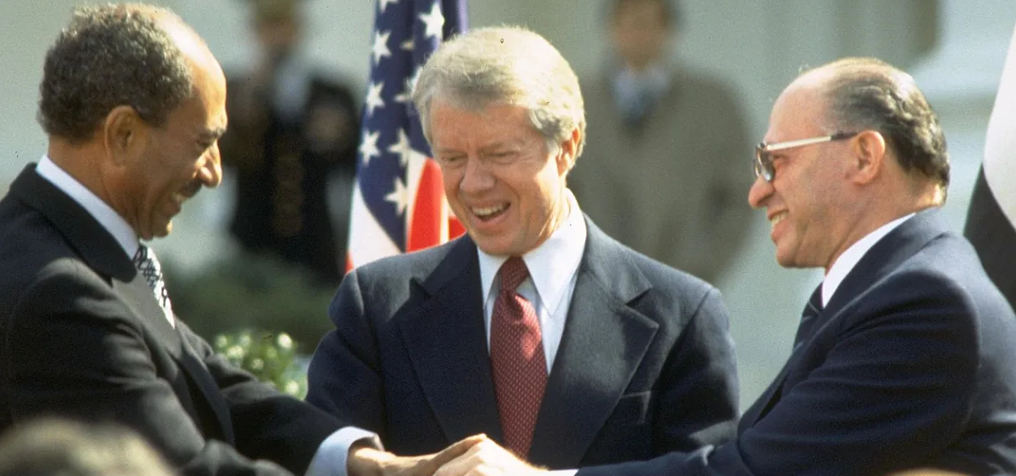

Military
Power
Israel Power Balance
Economic Power
Social
Power
Diplomatic Power

Slide 5
Military Power
Israel Power Balance
Economic Power
Social Power
Diplomatic Power

Slide 6
Popular Israeli Perception
“Economic Stability”
“Financial Stability”
“Diplomatic Potential (e.g. joining the OECD)”
“Financing Security Expenses”
“A source of Social Resilience”

Slide 7

World Perception?

Slide 8
Before we get there, a little terminology…

Slide 9
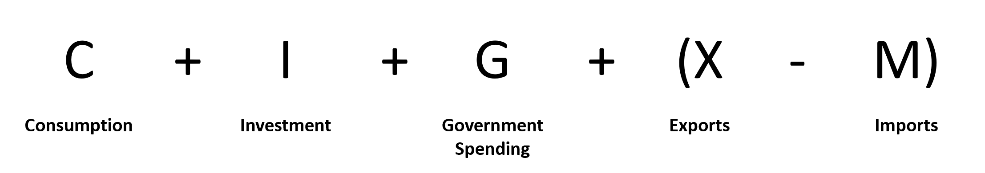
GDP(Gross Domestic Product)
the total monetary or market value of all the finished goods and services produced within a country's borders in a specific, minus goods imported and used as raw materials.
(Yosef Zeira – Israel Economy)
“The actual use of goods and services by the end consumer to satisfy human wishes and needs, real or not in a way that the used goods change or wear out therefore cannot be reused or recognized as their original form”

Slide 10
GDP(Gross Domestic Product)
the total monetary or market value of all the finished goods and services produced within a country's borders in a specific, minus goods imported and used as raw materials.
(Yosef Zeira – Israel Economy)
“The portion of the GDP that was not used for consumption but will be put into increasing production power in years to come. As far as the economy goes, national investment is only the realistic addition to all tangible real assets (buildings, equipment, stock, etc.)”

Slide 11
GDP(Gross Domestic Product)
the total monetary or market value of all the finished goods and services produced within a country's borders in a specific, minus goods imported and used as raw materials.
(Yosef Zeira – Israel Economy)
“The total amount governments and local authorities spend for all purposes or specific purpose.”

Slide 12
GDP(Gross Domestic Product)
the total monetary or market value of all the finished goods and services produced within a country's borders in a specific, minus goods imported and used as raw materials.
(Yosef Zeira – Israel Economy)
“In the Balance of Payments – the difference between the import and export in the Current Account. When export is larger than import the, there is a positive export surplus; when import is bigger than export – it is negative. In other words: there is an import surplus”

Slide 13
GDP(Gross Domestic Product)
the total monetary or market value of all the finished goods and services produced within a country's borders in a specific, minus goods imported and used as raw materials.
(Yosef Zeira – Israel Economy)

Slide 14
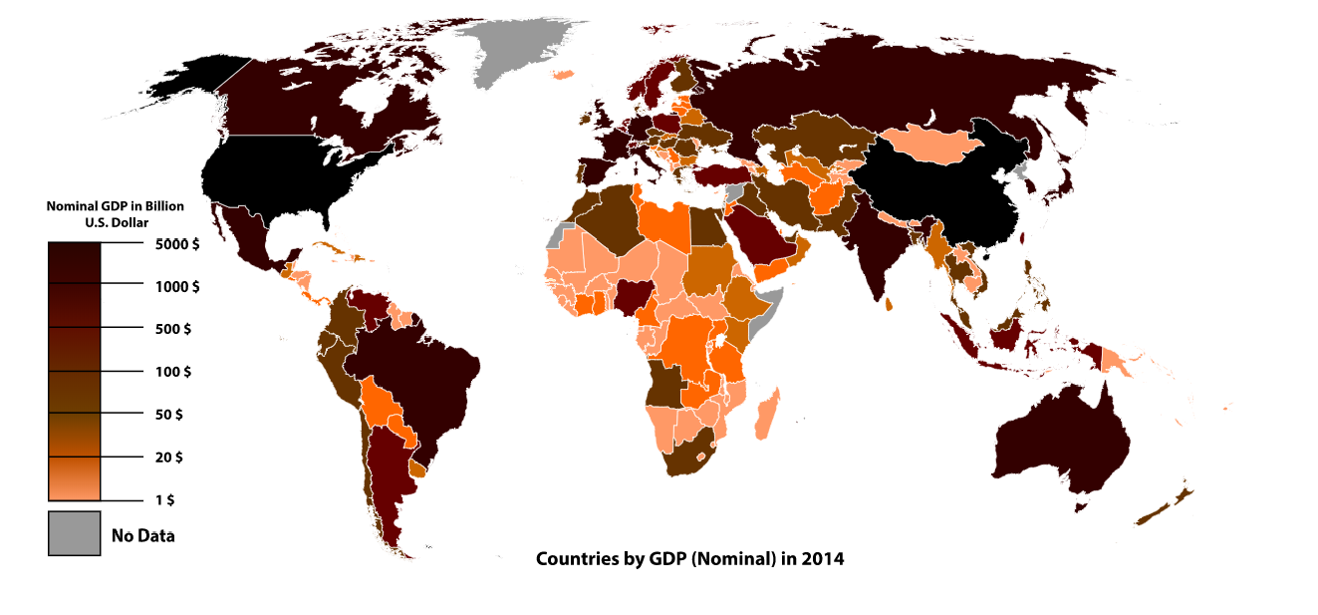

Slide 15
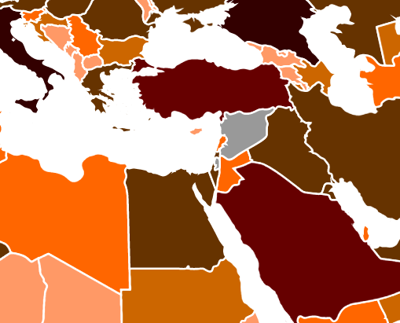

Slide 16
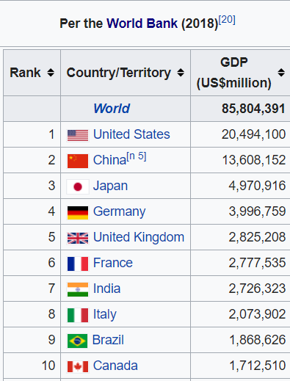
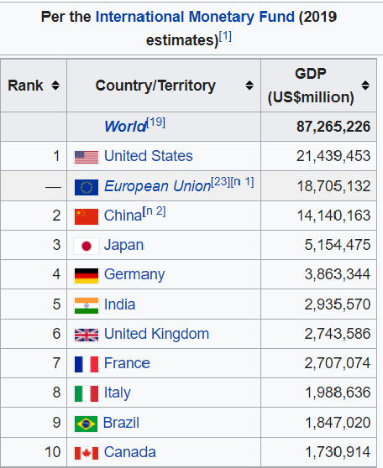

Slide 17
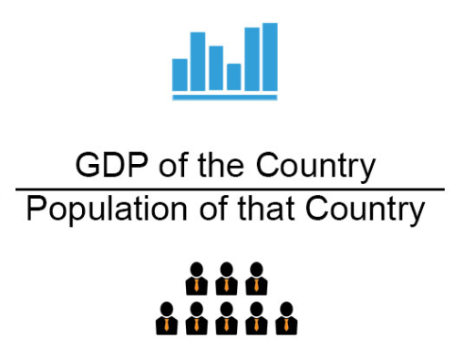
GDP Per Capita
Per Capita: Gives an idea about the average quality of life in the economy

Slide 18
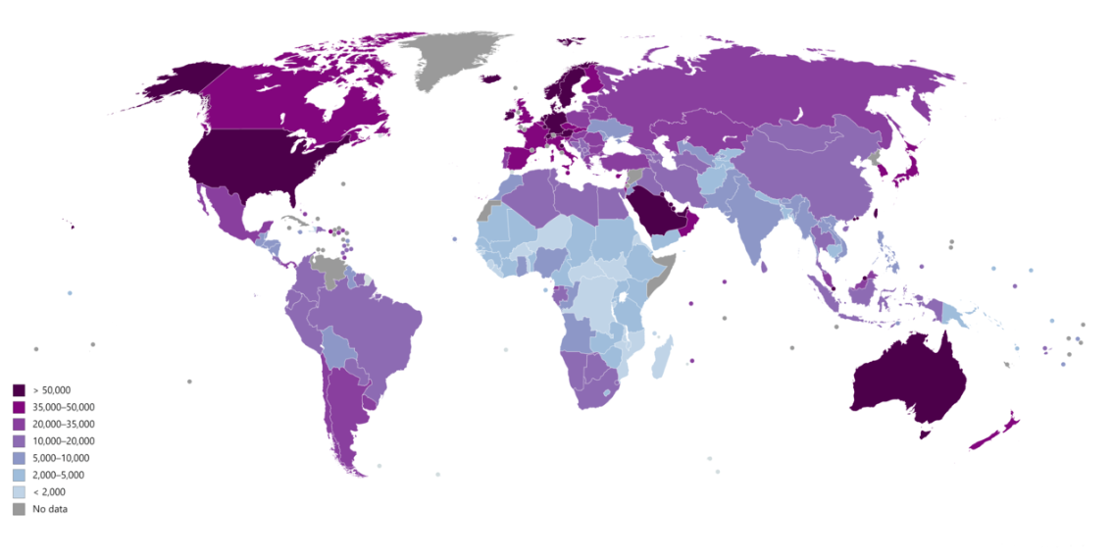
Countries by GDP (PPP) per capita (Int$) in 2018 according to the IMF

Slide 19
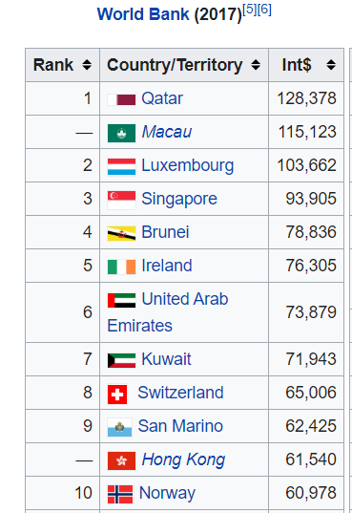
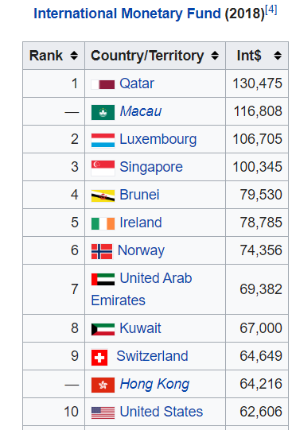

Slide 21
GDP Per Capita – International Comparison
(in USD; adapted to purchase power terms, 2018)
OECD Rank/year | Israel | Ireland | S. Korea
1980 | 23 | 22 | 30
1990 | 23 | 21 | 27
2000 | 22 | 7 | 27
2010 | 23 | 6 | 22
2018 | 23 | 2 | 19
USD
מקור: IMF

Slide 22
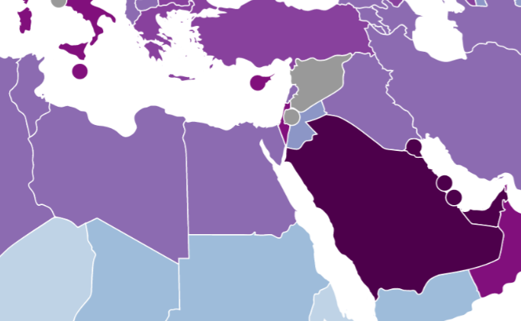

Slide 23

State Resources

Slide 24
Water Reuse
Israel reuses 85% of the treated effluents
Ability to supply all the agricultural needs
Membrane treatment of sewage
Israel’s strategic goal for the next decade is to increase the reuse above 90%
100%
100%
100%
100%
100%
100%
>90%
The Goal >
90% Reclamation
90%
90%
90%
90%
90%
90%
85%
80%
80%
80%
80%
80%
80%
70%
70%
70%
70%
70%
70%
60%
60%
60%
60%
60%
60%
50%
50%
50%
50%
50%
50%
40%
40%
40%
40%
40%
35%
40%
30%
30%
30%
30%
30%
30%
20%
20%
14%
20%
14%
15%
11%
20%
20%
20%
10%
10%
10%
10%
10%
10%
0%
0%
0%
0%
0%
0%
Spain
China
USA
Australia
Singapore
Israel
24
*GWI Municipal Water Reuse Markets 2010
Notes:
Water is a strategic asset in Israel and we consider the effluents to be a water resource in every sense of the word.
The State of Israel reuses 85% of the treated effluents –the highest rate in the world.
Mekorot is directly responsible for the reuse of more than 60% of the treated effluents in Israel.
Our strategic goal for the next decade is to increase the reuse to 90%.
In order to achieve this goal, Mekorot invests significant resources in the development of new cutting-edge technologies,
both in order to increase output and to improve the quality of the effluent and reduce costs.
The high quality effluent that is used for irrigating agricultural crops enables freshwater, previously supplied for agricultural purposes,
to be redirected to the domestic sector. This important activity thus contributes to the enhancement of Israel’s water industry.

Slide 25

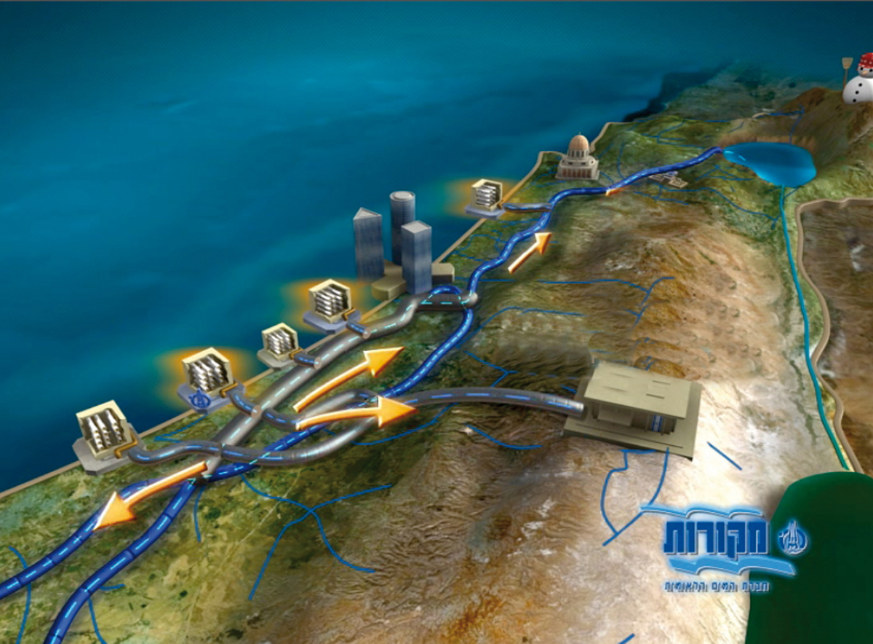
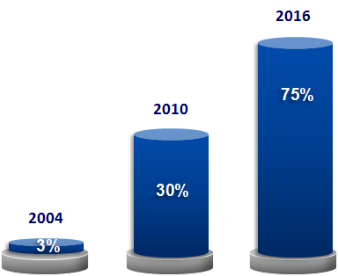
Desalinized water - Game Changer
Hadera (127)
since 12/09
Sorek (150)
since 8/13
Palmachim (90)
Since 6/07
Ashdod (100)
Since 12/15
Ashkelon (120)
Since 12/05
Since 2016, 75% Of The Drinking Water
Comes From Desalination Facilities
Notes:
The arid climate and lack of water requires us to locate and develop alternative water sources, Desalination is one of the main solutions to this problem.
We have just completed the construction of the Ashdod Seawater Desalination Plant, for the supply of 100 million cubic meters of water per year. The Ashdod plant is part of an entire New National Water System that includes 5 seawater desalination plants.
Mekorot is in the final construction stages of the New National Water Carrier - a huge infrastructure system, one of the largest in the country,
which changes the direction of water flow in Israel, no longer just from the north to the south – but also from the west in all directions.
This is no less than a breakthrough and a huge operational challenge.
At the end of this revolutionary process, by 2016,
75% of Israel’s drinking water will be desalinated water.

Slide 26
2050
Water Sources
1,020
930
130
70
2.0%
1,421
2010
425
174
1,200
284
Efluents
23
Sea water desalination
Brakish
Brakish water desalination
Natural Recharge

Slide 27
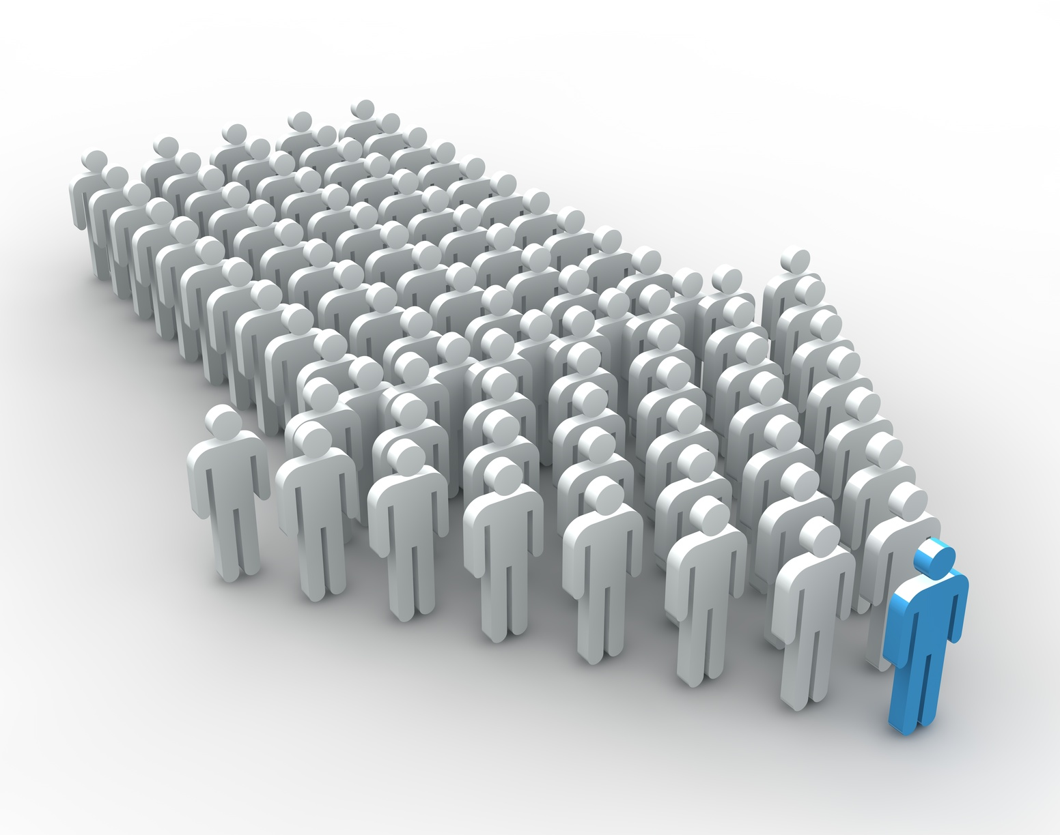
Human Capital

Slide 28
Market data still indicates employment at almost full capacity
Participation Rate (right Axis)
Unemployment Rate
(Left Axis)
* חודשים ינואר - נובמבר

Slide 29
Positive trends in the past 15 years: Dramatic Workforce Improvement
Participation rate, main employment ages (25-64)
Orthodox Women
Arab Women
Non-Orthodox Women
Orthodox Men
Arab Men
Non-Orthodox Jews
Source: CBS

Slide 30
Future Demographic Trends
Relative Portions of Population Groups
Source: CBS & Bank of Israel

Slide 31
Life Expectancy of Men and Women Aged 65
Source: CBS

Slide 32
Increased Dependency
Ages 20-64 in relation to ages 65 and up
Source: CBS

Slide 33
Ratio between capital and work hours in Israel is the lowest in the Western World
Net Capital level (private +public, no housing) per hour’s work
2013, PPP, 2010 prices
Source: Aharon Institute

Slide 34
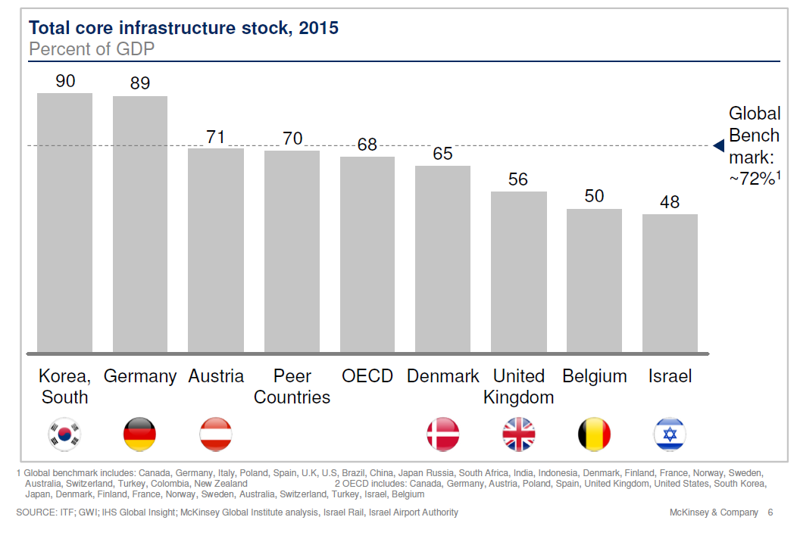
Public Capital and Transportation Infrastructure

Slide 35
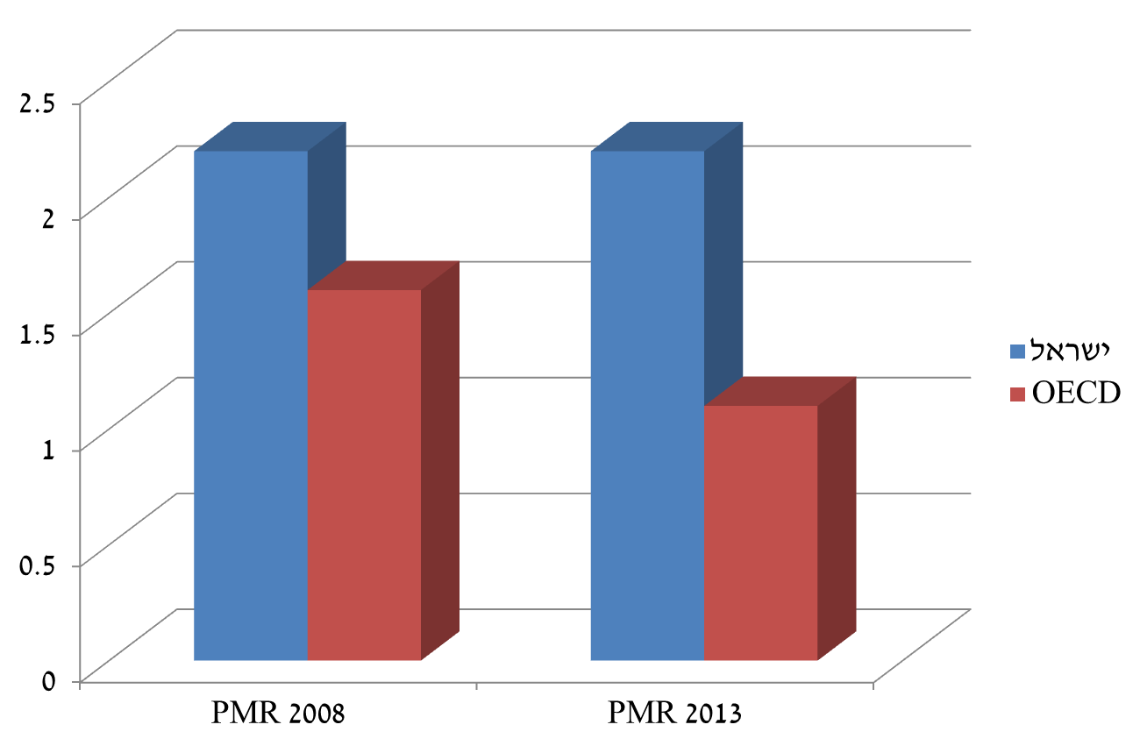
The main business environment characteristics also indicate that Israel is far behind the OECD
Israel’s rank in the Doing Business Index for 20017 and 2017
Product Market Regulation Index
Asset Registry
Tax Payment
Contract Enforcement
Construction Permits
Electricity Connection
International Trade
Line of Credit
Opening Businesses
Handling Bankruptcy
Small Investors Protection
סעיפים שנמצאו מתואמים עם הפריון
Factors Correlating with Productivity
Israel
*Out of 190 Countries; the higher the score, the more negative the situation
*The higher the score, the more negative the situation
* דירוג מתוך 190 מדינות. דירוג גבוה יותר משקף מצב שלילי יותר
* ציון גבוה יותר משקף מצב שלילי יותר

Slide 36
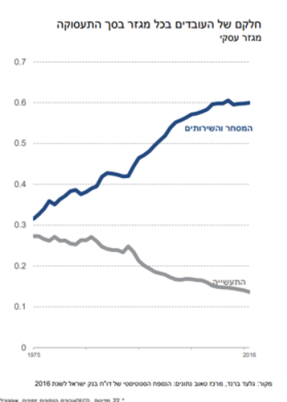
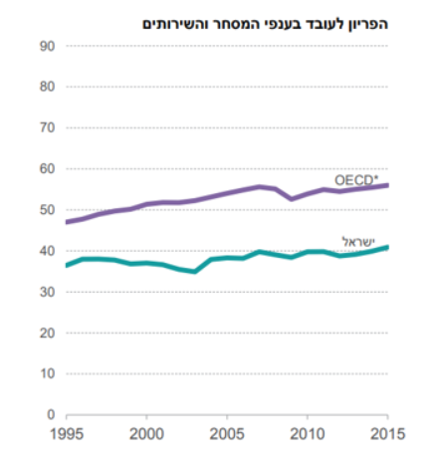
Significant productivity level gap in trade and services
Share of workers in every industry out of total employment
Business Sector
Productivity per worker in trade and services
Trade & Services
Israel
Industry
Available data for 22 OECD countries: Australia, Czech Republic, Denmark, Finland, France, Germany, Hungary, Greece, Israel, Italy, Japan, Latvia, Luxemburg, The Netherlands, Portugal, Slovakia, Slovenia, Spain, Sweden and the UK.
*Trade services include wholesale and retail, transport, storage, post and currier services, hospitality and dining.
מקור: בנק ישראל ומכון טאוב.
Source: Bank of Israel and the Taub Institute

Slide 37
Quality of life in Israel is relatively low, mainly due to low productivity
Ratio between Israel and the US and the OECD average of GDP
levels and productivity exhaustion, 2014
“Productivity isn't everything, but, in the long run, it is almost everything. A country’s ability to improve its standard of living over time depends almost entirely on its ability to raise its output per worker.” (Paul Krugman)

Slide 38
Population is relatively educated yet many lack appropriate skills
PEAK (Math) Result Distribution – Israel and OECD Average, 2016
Average Education Years, Ages 35-54, 2010
USA
Switzerland
Israel
Czech Republic
Slovakia
Germany
Ireland
Canada
Korea
Denmark
Estonia
Japan
UK
Sweden
Slovenia
Hungary
Australia
Norway
New Zealand
The Netherlands
Poland
Belgium
Finland
Greece
France
Latvia
Spain
Italy
Iceland
Austria
Chile
Mexico
Portugal
Turkey
Source: OECD
Source: Dan Ben David (Shoresh Institute),
based on Barro and Lee data

Slide 39

Inequality levels in Israel are high yet on the decline – as opposed to most developed countries
Inequality - Net
Inequality - Gross
מקור הנתונים: SWIID, המוסד לביטוח לאומי; עיבודי אגף הכלכלן הראשי
Source: CBS & OECD
Israel
USA
OECD

Slide 40
What does that have to do with Economic Power?

Slide 41
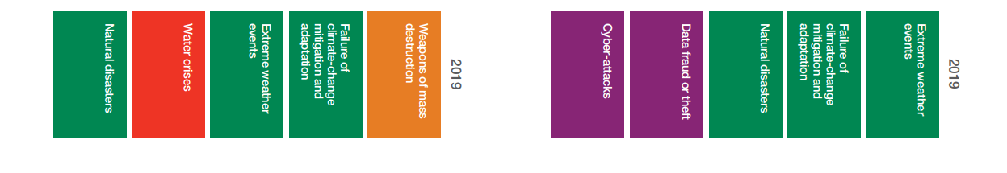
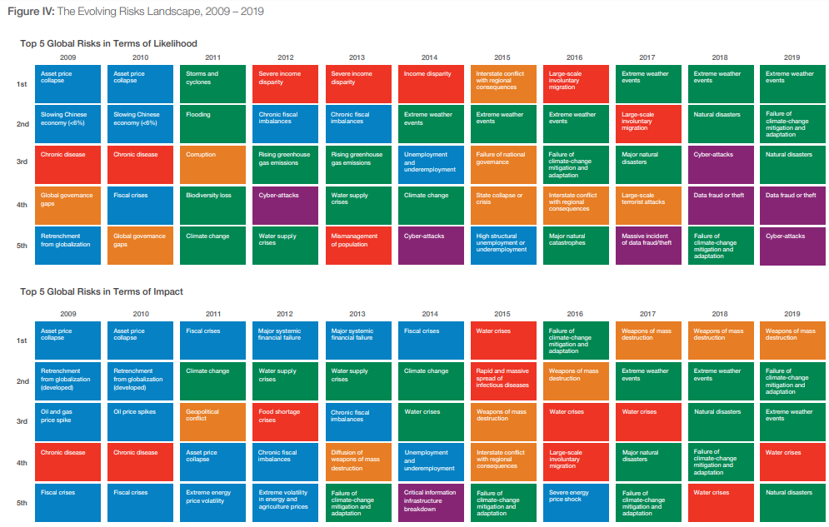

Slide 42

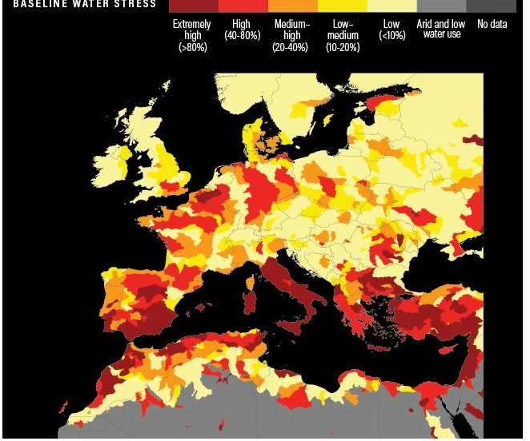
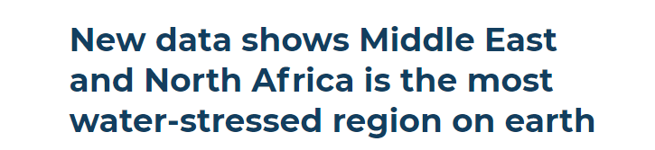
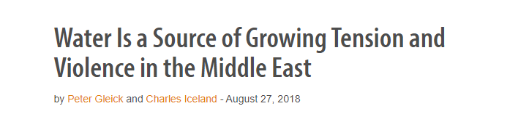

Slide 43
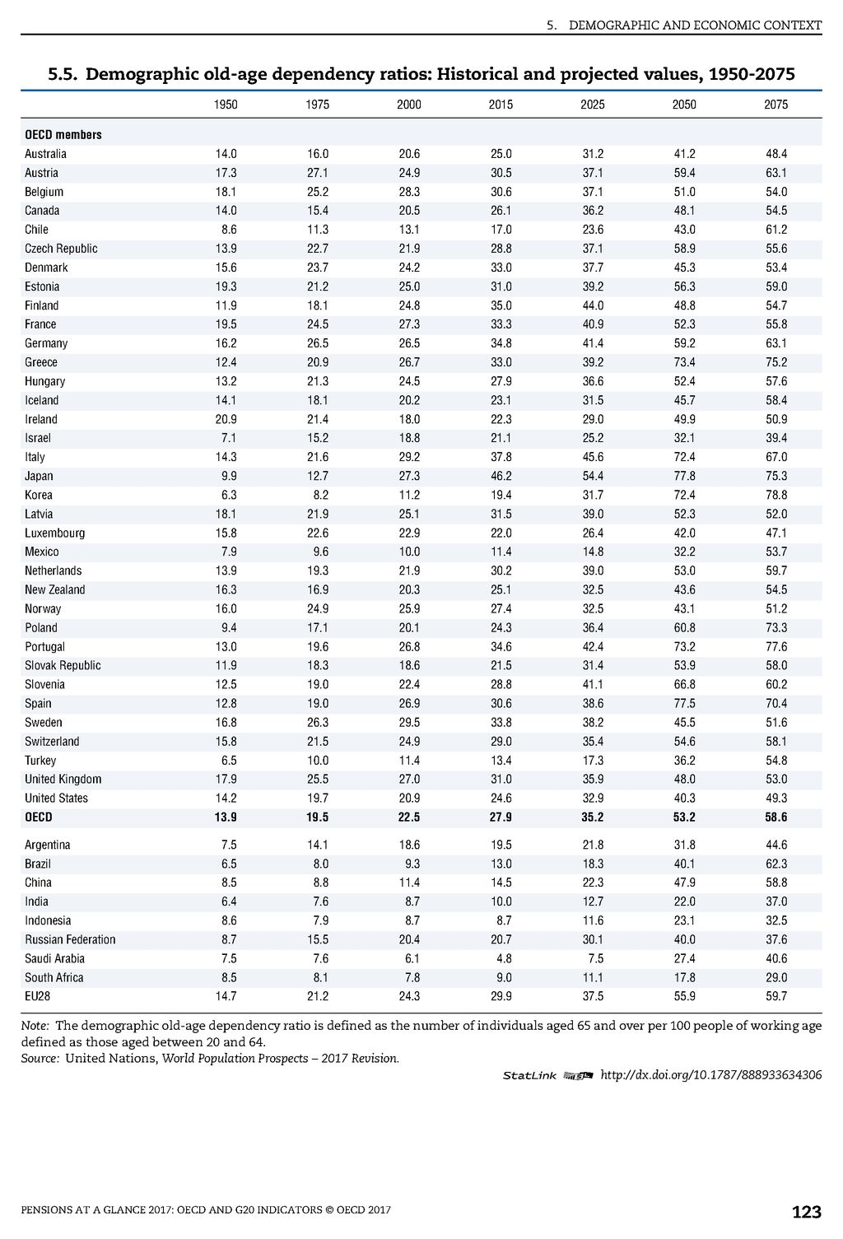

Dependency Ratio
OECD

Slide 44
How do we turn relative advantages to influential tools on a national security level?

Slide 45
World Perception

Slide 46

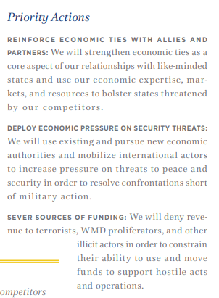
מדינאות כלכלית

Slide 47
Some Terminology…

Slide 48
Economic Sanctions
Economic Boycott – all encompassing economic damage that could possibly even lead to humanitarian harm (Iraq 1993-4)
Specific Sanctions – sanctions against industries or specific actions; these sanctions are defined in the fields of weapons (embargo); finance, trade, staple produce (Crude oil, diamonds, trees, gas etc); travel/flight; diplomatic action and many more

Slide 49
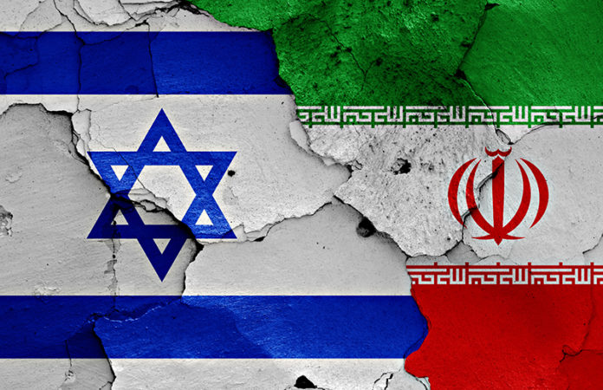
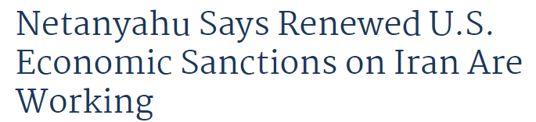

Slide 50
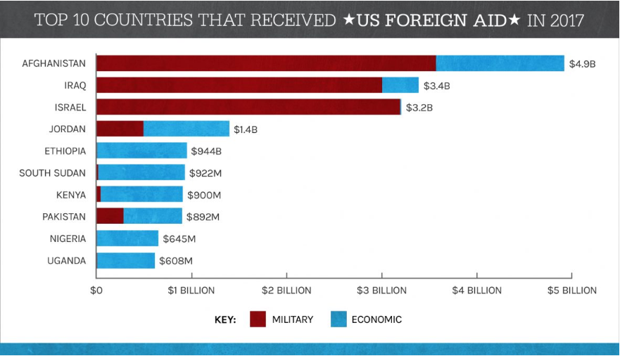
US Aid
Foreign aid is defined as the voluntary transfer of resources from one country to another country. This transfer includes any flow of capital to developing countries .Foreign aid can be in the form of a loan or a grant. It may be in either a soft or hard loan. This distinction means that if repayment of the aid require.s a foreign currency, then it is a hard loan. If it is in the home currency, then it’s a soft loan. The World Bank lends in hard loans, while the loans of its affiliates are soft loans.

Slide 51
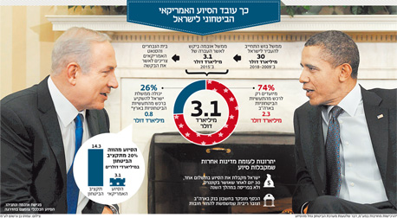
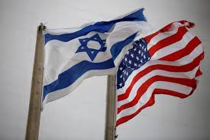
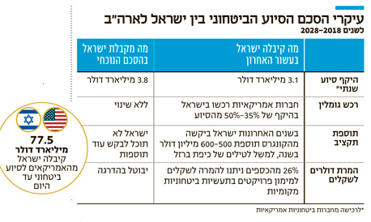


Slide 52
Trade Agreements
Free Trade Zone Agreement
The purpose of the agreement was to improve mutual access to goods and services; to provide legal defense for investments and intellectual property and other aspects by decreasing customs tariffs on goods, removing customs barriers, reducing regulation and technical obstacles for trade; expanding access to government tenders and more.
The Free Trade Zone includes many chapters detailing economic and trade standards.
(*Ministry of Finance website)

Slide 53

שיעור 3

Slide 54
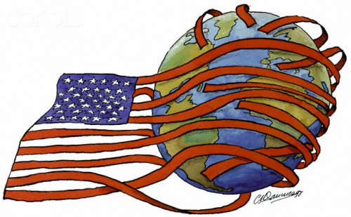

Soft Power
Hard Power
העוצמה החכמה
Gaining influence over the target country by attraction rather than coercion
Gaining influence over the target country by coercion

Slide 55
Example

Slide 56
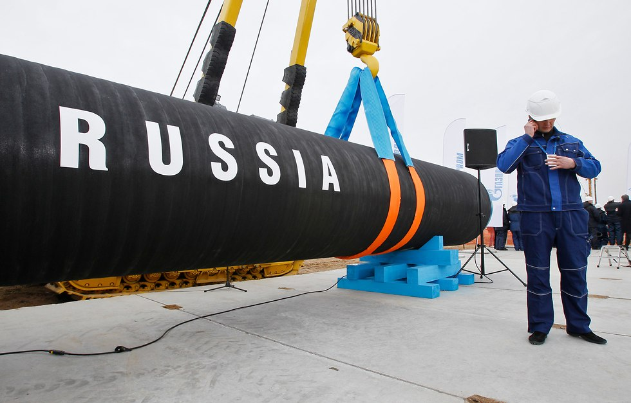
שיעור 3

Slide 57
Nord Stream 2
11 Billion USD
Gas Pipe from Eastern Russia to Northern Germany
1,200 km
Expected to double Russian natural gas export (Washington Post)

Slide 58
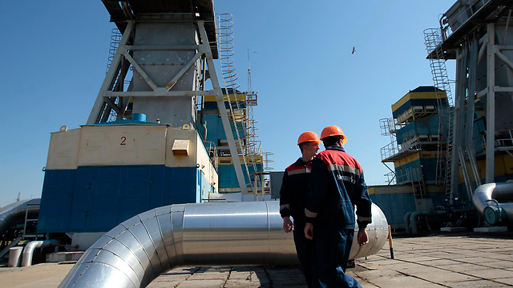
2008
War on Gas Between Russia and the Ukraine Threatens Supply to Europe
The Russian Invasion of the Ukraine is About Natural Gas
Notes:
מלחמת גז בין רוסיה לאוקראינה מאיימת על האספקה לאירופה
חברת הגז והנפט הרוסית גזפרום הודיעה כי תפסיק את הזרמת הגז לאוקראינה מאחר וההסכם בין הצדדים הסתיים. צינורות הגז למדינות רבות באירופה עוברים דרך שטחה של אוקראינה והיא מאיימת להפסיק זאת
אולגה ויניאר17:0731.12.08
תגיות:אוקראינה
רוסיה
גז
הנהלת גזפרום, חברת הגז והנפט הגדולה ביותר ברוסיה, הודיעה לממשלת אוקראינה כי מחר (ה') בשעה 10:00 בבוקר תפסיק את הזרמת הגז למדינה מאחר וחוזה ההתקשרות בין הצדדים תם הלילה וטרם נחתם הסכם חדש. סגן יו"ר מונופול הגז הממשלתי, אלכסנדר מדבדב, הדגיש כי אם לא ייחתם הסכם חדש עוד הלילה,
לא תחול חובה משפטית להמשיך ולהזרים גז למדינה.
האוקראינים הודיעו בתגובה כי יעצרו את אספקת הגז הרוסי לאירופה, שכן צינורות ההובלה עוברים דרך שטחה ובהיעדר הסכם עם הצד הרוסי, היא אינה חייבת לאפשר לה להשתמש בצינור. הרוסים כינו את המהלך "סחטנות אוקראינית", שכן לדבריהם העבירו לאוקראינה מקדמה עבור השימוש בצינור. הם גם מיהרו להזהיר את צ'כיה, שקבלה לידיה את הנשיאות באיחוד האירופי, כי בשל הסכסוך עשוייה כל היבשת להישאר ללא אספקת גז וקראו לנקוט בסנקציות כנגד אוקראינה.
בין הלקוחות שעלולים להיפגע נמצאות המדינות איטליה, אוסטריה, פולין, הונגריה, קרואטיה, סולובקיה ורומניה, כאשר החלק הארי של הגז שהן צורכות מגיע מרוסיה. מלחמות הגז הללו ערב תחילתה של שנה אזרחית חדשה הפכו לשגרה בין רוסיה לאוקראינה, והן חוזרות על עצמן זו השנה הרביעית. לרוב הן נסבות סביב מחירי הגז אותו רוסיה מייקרת ללא הרף אך השנה סיבת המחלוקת היא שונה. רוסיה דורשת משכנתה להחזיר לה חוב בסך 2.4 מיליארד דולר ואילו אוקראינה טוענת שהחוב אינו עולה על יותר מ-1.5 מיליארד דולר.
אנליסטים מעריכים כי הסיבה האמיתית למחלוקת בין הצדדים היא סיוע בהיקף 16 מיליארד דולר שאוקראינה קיבלה מקרן המטבע הבינלאומית. רוסיה, המעוניינת לקבל לפחות חלק מסיוע החירום, תעשה כל שביכולתה על מנת לשים עליו את ידה. לדברי אותם אנליסטים, מציאת חובות ישנים ומפוקפקים, כמו גם העלאת מחירי הגז, הן הדרכים בהן משתמשת רוסיה על מנת לנכס לעצמה חלק מהכסף.
כיום רוכשת אוקראינה גז במחיר מוזל של 179.5 דולר לאלף מ"ק. רוסיה הסכימה להקפיא את המחיר המוזל עד שנת 2011, בתנאי שאוקראינה תחסל את כל חובותיה לגזפרום. במידה והחובות לא יוחזרו, תספק רוסיה לשכנתה גז במחירי השוק, כבר ב-2009. פירוש הדבר שמחיר הגז עלול להרקיע ל-400 דולר לאלף מ"ק.

Slide 59
Why is the pipe so important to Russia that it would justify such extreme action?!

Slide 60
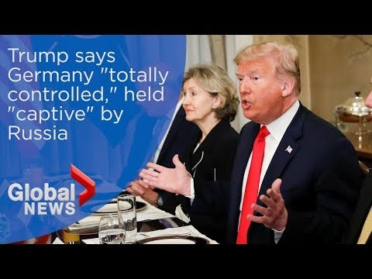

Slide 61

Back to Israel…

Slide 62
State Budget

Slide 63
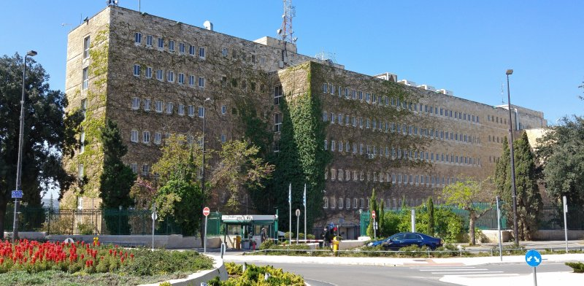

Economic Policy
Fiscal Policy
Monetary Policy
Ministry of Finance
The Bank of Isral

Slide 64

State Budget
Free Education Ages 3-4
Income Tax
Subsidized Public Transportation
VAT
Security
Excise Tax on Petrol
Increasing Medical Basket
Higher and constantly increasing quality of life for the entire population

Slide 65
Work Method
Macro-economic Situation
Local Economy Challenges
Economic Plan/Reforms
State Budget

Slide 66

Game Rules
Debt and Deficit
Tax Policy
Government Spending

Slide 67
Tax Burden - 2002
מקור: OECD

Slide 68
Tax Burden as a Percentage of the GDP - 2018
מקור: OECD

Slide 69
Today, the low tax burden is designed to encourage growth and employment
Direct Tax Burden
Data for 2016, as a percentage of the GDP
Indirect Tax Burden
Data for 2016, as a percentage of the GDP
מקור: OECD
Notes:
נטל המס הישיר בישראל ירד באופן משמעותי החל בשנת 2003 ונותר נמוך במטרה לשמור על התמריצים בשוק העבודה.
נטל המס העקיף יחסית גבוה בהשוואה בינלאומית
הרכב המיסוי הזה משמר את התמריצים בשוק העבודה שעודדו את הגידול בשיעור ההשתתפות והתעסוקה בכל קבוצות האוכלוסייה וברחבי הארץ

Slide 70
Narrow Tax Base – 13% of employed people contribute over 70% of income tax revenue
Number of Tax Payers by Tax Bracket
Revenue by Tax Bracket

Slide 71
Narrow Tax Base
20% Workers Responsible for Over 80% of the Direct Tax Income
Direct Tax Payment by Socioeconomic Decile

Slide 72
Game Rules
Debt and Deficit
Tax Policy
Government Spending

Slide 73
Budget Building Start Point:
High Defense and Interest Expenses and a Relatively Low Tax Burden
Defense Expenses
Interest Expenses
מקור: OECD
Notes:
1 . בואו נניח את השכונה בה אנו גרים לרגע בצד. לגבי תשלומי הריבית – אם נשכיל היום לשמור על גרעון נמוך אז נפנה לעצמנו מקור עתידי בשנים הבאות.
2. לגבי תקציב הביטחון – נדבר בקצרה בהמשך.

Slide 74
Defense Expenses as a percentage of the GDP - 2002
Israel
Turkey
Korea
Russia
Denmark
Portugal
India
Germany
Thailand
France
USA
Source: SIPRI

Slide 75
Defense Expenses as a percentage of the GDP - 2017
Source: SIPRI

Slide 76
Interest Payments to GDP Ratio - 2002
%
Source: OECD

Slide 77
Interest Payments to GDP Ratio - 2018
%
Source: OECD

Slide 78
Public expenditure was reduced up to 2011 mainly due to the reduction of the defense and interest burden; public expenditure returned to its level in 2004
Public Expenses
Interest Payments
Defense Expenses
מקור: למ"ס
Notes:
החל משנת 2003 חלה ירידה בהוצאה הציבורית. משנת 2011 ההוצאה הציבורית יציבה על כ-40% תוצר
רוב הירידה נובעת מהפחתה משמעותית בהחזרי החוב ומשחיקה של ההוצאה הביטחונית כאחוז מהתוצר.
החל משנת 2011 הצלחנו להגדיל השקעה בהוצאה האזרחית, וזאת תוך שמירה על היקף ההוצאה הציבורית בהיקף של כ- 40% תוצר.
המשך גידול צפוי לאור המדיניות הממשלתית והחקיקה בשלוש השנים האחרונות כפי שנראה בהמשך.

Slide 79
Public Expenditure as a percentage of the GDP - 2002
Source: OECD

Slide 80
Public Expenditure as a percentage of the GDP - 2018
מקור: OECD

Slide 81
Game Rules
Debt and Deficit
Tax Policy
Government Spending

Slide 82
Deficit Development; expenses and revenue of the state budget as a percentage of the GDP in years 2014-2019 – last 12 months accumulation
אחוזי תוצר
GDP Percentages
GDP Percentages
Deficit Development (Left Axis)
State Expenses (Right Axis)
אחוזי תוצר
State Revenue (Right Axis)

Slide 83
Deficit Aberration in Relation to the Economy’s Good Standing
Deficit – turnover offset OECD and Israel 2001-2018
אחוזי תוצר
OECD
Israel
90 Percentile
10 Percentile
מקור: OECD

Slide 84
Debt to GDP ratio has gone down since 2003 though the markets fear that 2018 me be an inflection point
%
Debt to GDP ratio, F1997-2020
A deficit cap must be set in order to prevent GDP ratio to go up yet a third consecutive year; such a sequence hasn’t occurred since the economic crisis during the second intifada

Slide 85
For the first time since 2012, the year ended with a deviation from the deficit cap permitted by law
Deficit cap and actual deficit as a percentage of the product F2000-2023
Actual Deficit
Deficit Cap
מקור: משרד האוצר

Slide 86
Removing the interest payment burden made way to increasing public spending to 40 Billion NIS per year
מקור: למ"ס

Slide 87

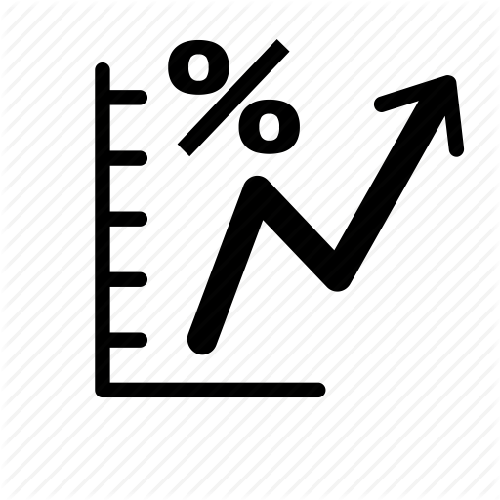
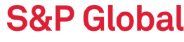


An increase in the public debt will damage the local economy and welfare of the country’s citizens
Credit Ranking Damage
Raised Interest on Debt
Allocation for Interest Payment, and compromising public services

Slide 88
2020 Budget Consolidation
Streamlining
Along Side Expenditure
Revoking
Unjustified
tax Breaks
Taxation on Externalities
Other Policy Measures

Slide 89
2018 trends showed a growth slowdown; over the next few years, growth is expected to reach the long-term potential
World Economic Crisis
Second Intifada
מקור: למ"ס. *2018 – תחזית למ"ס, 2019 ואילך תחזית כלכלן ראשי מעודכנת לינואר 2019

Slide 90
Responsible policy change enables a gradual decline in deficit – GDP ratio to 60% of the GDP
Deficit –GDP ratio development , 2003-2018
Source: Ministry of Finance, *2019 initial assessment

Slide 91
Removing the interest payment burden made way to increasing public spending to 40 Billion NIS per year

Slide 92
Given the deficit level in recent years, the debt to GDP ratio cannot be maintained in its current level
Public debt –GDP ratio; actual data for 2007-2018; 2019-2025 based on scenario simulation
Convergence into Expenditure Limits
without Convergence into the Deficit Target
Convergence into the Deficit Law

Slide 93
Budget Building Methodology
Autopilot - Consequential growth
Growth within expenditure limits
Budget adaptation (as high as the gap accumulated)
Growth and revenue prospect + approved budget
Deficit
Allowed Growth
Budget is not
within
deficit cap
Budget is
within
deficit cap
Autopilot
Gap
Original Budget
20XX
Deficit XX20
גידול מותר
תקציב מקורי
לשנת 2016
Expected Tax Revenue 20XX
Further adaptations
to revenue
or budget

Slide 94
Fiscal Policy Tools: Debt Cap
Actual Debt
Debt Cap by Law
New Debt Outline
*According to predicted performance in 2016 and the updated predicted income for August 2016
Source: Ministry of Finance

Slide 95
2019 Will be the second year of debt increase
Debt – product ratio development 2003-2018

Slide 96
Budgeting
(Original Gross Budget – No Principle Returns)
Retirement Pensions
4%
Other
13%
Defense
20%
Public Security
4%
Staff Offices
5%
Basic and Higher Education 17%
Transport 5%
Health
10%
Debt Principle & Interest
12%
National Insurance
10%

Slide 97
Popular Israeli Perception
World Perception
“Economic Stability”
“Financial Stability”
“Diplomatic Potential (e.g. joining the OECD)”
“Financing Security Expenses”
“A source of Social Resilience”

Slide 98
Would the perception shift of economic power also change budgeting?

Slide 99
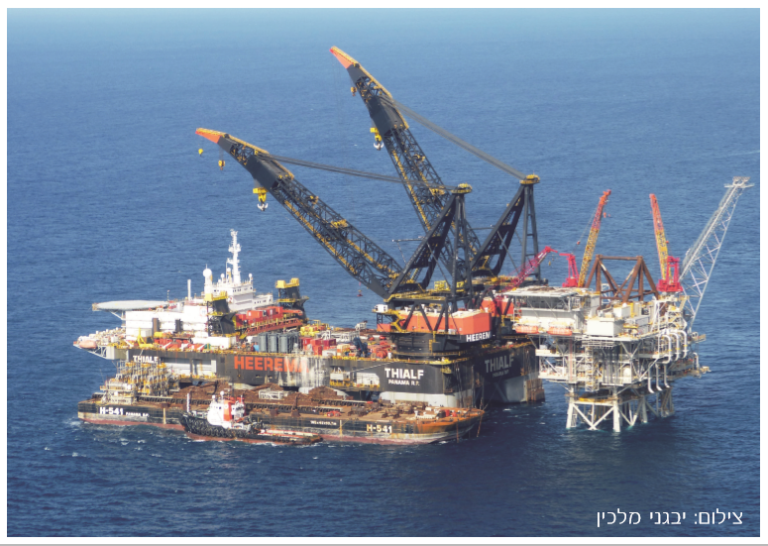
Exercise
Photo by: Yevgeni Malkin

Slide 100
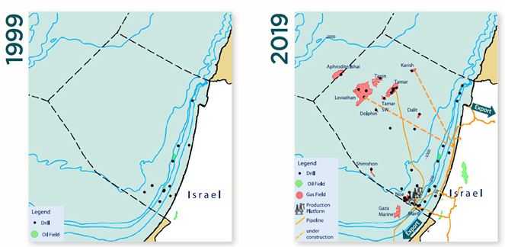
Israeli Gas Market Revolution

Slide 102
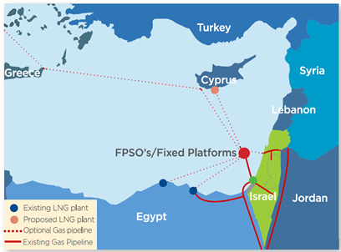
Export
Options

Slide 103
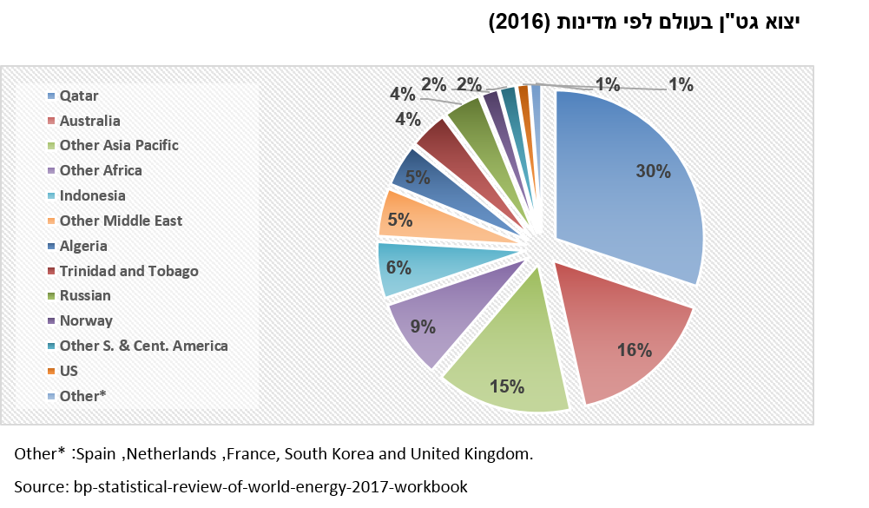
Liquefied Natural Gas (LNG) Export by Country 2016

Slide 104
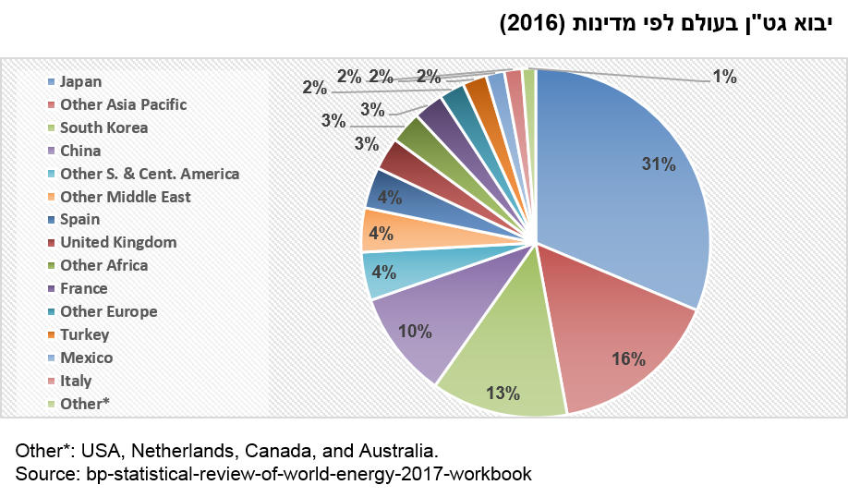
Liquefied Natural Gas (LNG) Import by Country 2016

Slide 105
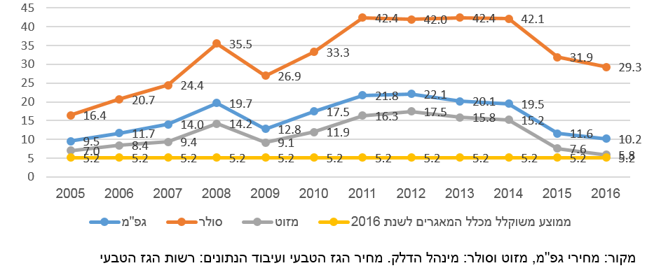
Petrol Prices in Israel 2005-2016
(USD to mmbtu)
LPG
Diesel
Mazut
Average of 2016 data from all sources
Source: LPG prices, mazut and Diesel: Petroleum Administration. Price of Natural Gas and Data Processing: Natural Gas Authority

Slide 106
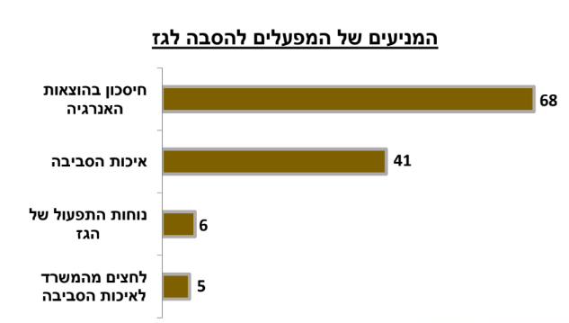
Ministry of Energy Survey – motives for connecting factories to the natural gas pipeline
Factories’ motivations to switch to natural gas
Energy Expenditure Savings
Environmental Concern
Easy
to Operate
MOE
Pressure

Slide 107
Table 2: Data and Annual Trends
Industry | Factor | Measurement Unit | 2015 | 2016 | 2017 | 2018 | % in Relation to the Previous Year
Supply | Total natural gas supply | BCM | 8.4 | 9.66 | 10.35 | 11.11 | 7%
 | Out of which: Tamar | BCM | 8.28 | 9.3 | 9.83 | 10.44 | 6%
 | Out of which: Maritime Connector | BCM | 0.13 | 0.36 | 0.52 | 0.67 | 29%
Consumption | Natural gas consumption for electricity production | BCM | 6.73 | 8.04 | 8.5 | 9.1 | 6.3%
 | Use of natural gas in industry | BCM | 1.67 | 1.62 | 1.81 | 2.02 | 12%
 | Use of natural gas for electricity production as a percentage of the total demand for natural gas | % | 79% | 83% | 83% | 83%
 | Use of natural gas for industry as a percentage of the total demand for natural gas | % | 17% | 17% | 17% | 17%
Network | Streaming | Km |  |  |  | 700
 | Distribution | Km |  |  |  | 350

Slide 108
What would you do?
Export?
Local Use?
Influence State Budget?

Slide 109
Thank You
נח הקר

