Slide 1
Strategic Studies Echelon
Introduction to Strategy
Lesson 2
December 2019

Slide 2
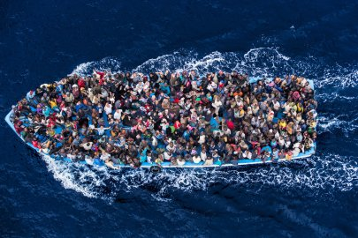
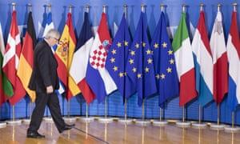
Intro to Strategy – Table of Contents
Recap of the Previous Lesson – Strategy as…
  Environment
  Understanding
Current Lesson – Strategy as…
  Planning
  Action (Intervention in the System)
Study Case – Immigration to Europe

Slide 3

Environment - complexity, dynamism, constant change, multiplayers, relationships, interactions, logic, phenomena and trends
Environment
Understanding
Design
Action
Previous Lesson

Slide 4

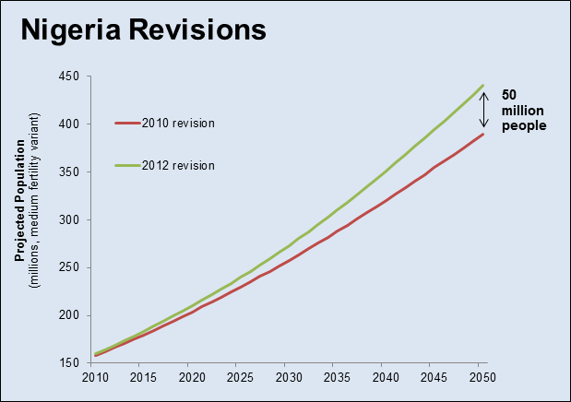
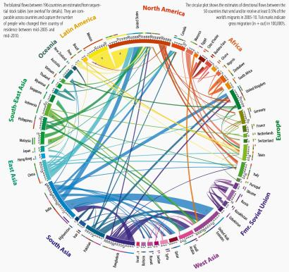
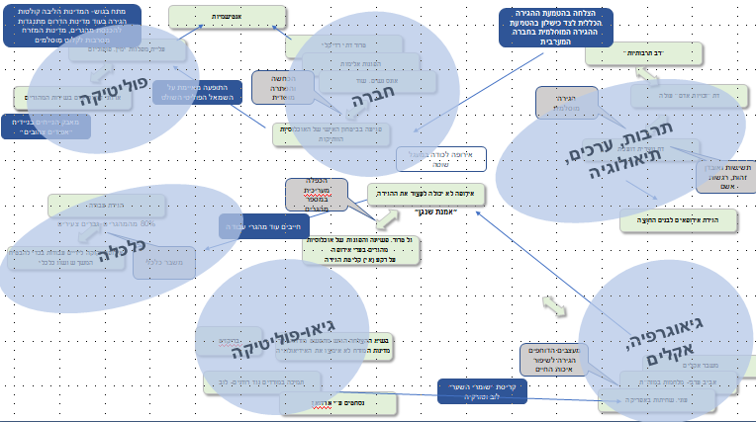
Components of the Strategic Environment
Affinities
Actors/Elements/Entities
A Unique Context
System Boundaries

Slide 5
Components of the Strategic Environment
Individuals or groups within the system that work to advance their various interests or others. Each player has a goal, resources, strengths and weaknesses. There are different types of actors (countries, terrorist organizations, corporations, individual figures, etc.).
Affinities
A Unique Context
System Boundaries

Slide 6
Elements of the Strategic Environment
The actors have functional or behavioral affinities, such as authoritative or subordination relations, ideological affiliations, or conflict of interests.
זיקות
Actors/Components/Entities
A Unique Context
System Boundaries

Slide 7
Elements of the Strategic Environment
Affinities
Actors/Elements/Entities
The boundaries of the system (conscious decision) allow us to understand through framing/discipline.
A Unique Context
גבולות

Slide 8
Elements of the Strategic Environment
Affinities
Actors/Elements/Entities
The environment is constantly undergoing changes as a result of the forces operating within it and its external forces. Therefore, the environment will always have one-time and unique circumstances.
הקשר ייחודי
System Boundaries

Slide 9
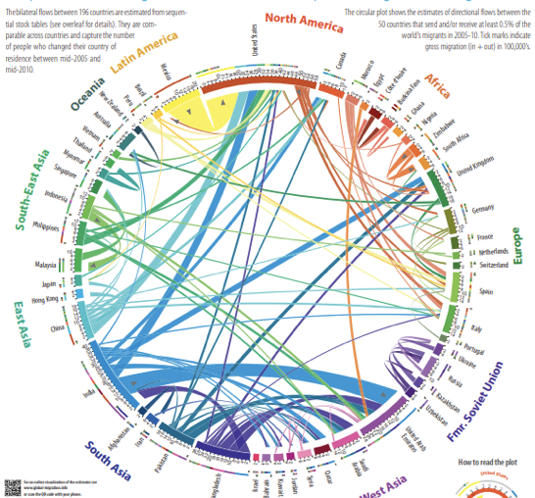

Slide 10

Understanding - A Critical Interpretation of Emerging Reality
(theorization/sense-making)
Environment
Understanding
Planning
Action
Previous Lesson

Slide 11
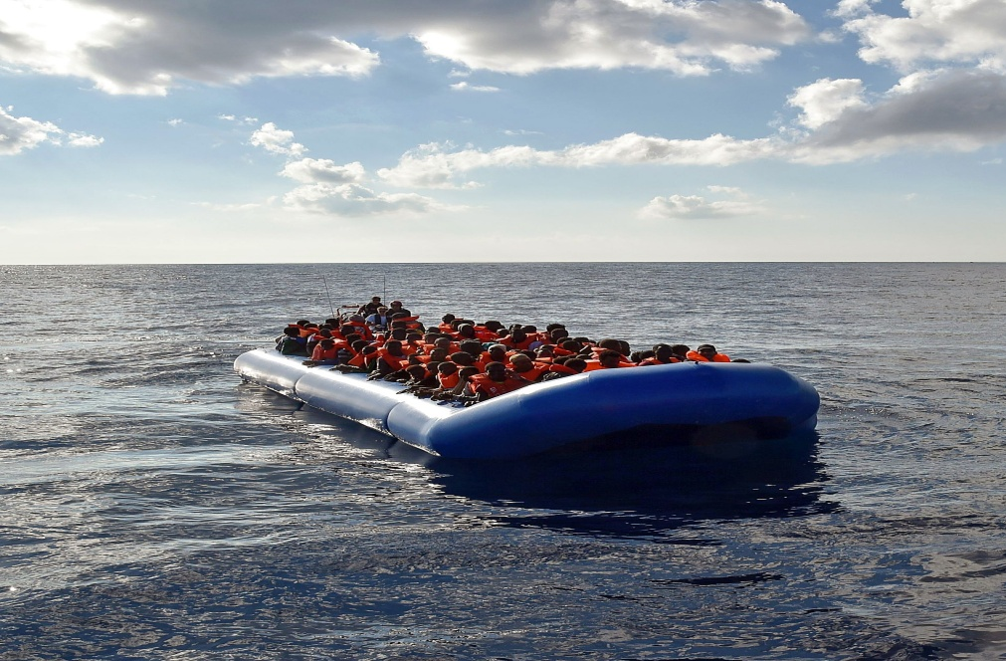
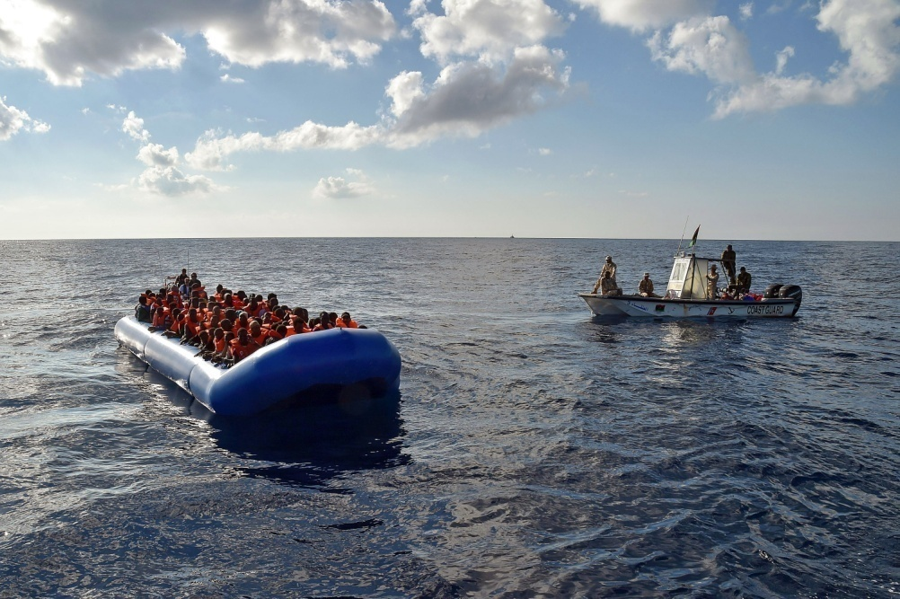
The Need for Framing and Reframing
"Any ongoing effort aimed at improving the reconciliation between perception of reality and observable reality will ultimately increase incompatibility...".
"... There is a way out ... a rationalistic and deliberate move of creating a higher, broader and more general concept of representing reality...".
John Boyd

Slide 12
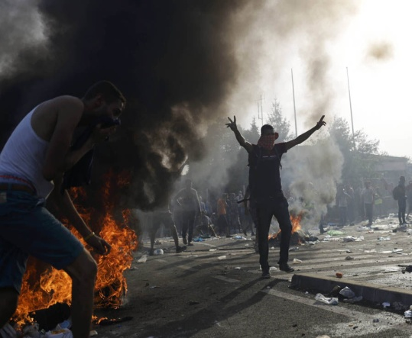
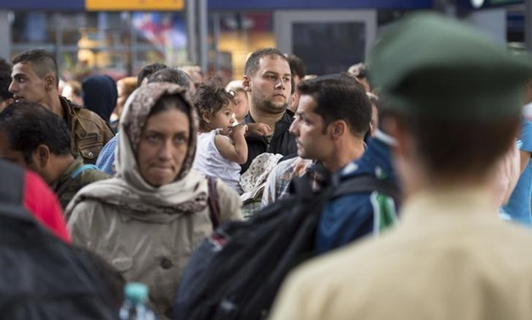

The Observable Phenomenon in Reality -
Migration to Europe
(Ontology)

Slide 13
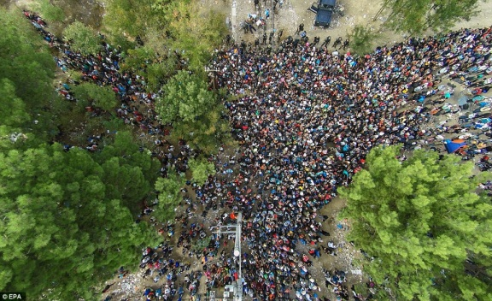
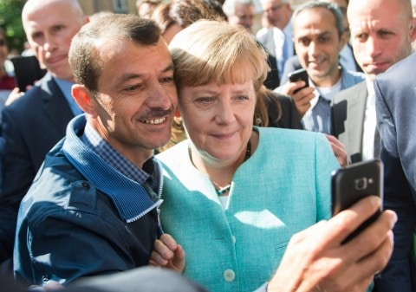
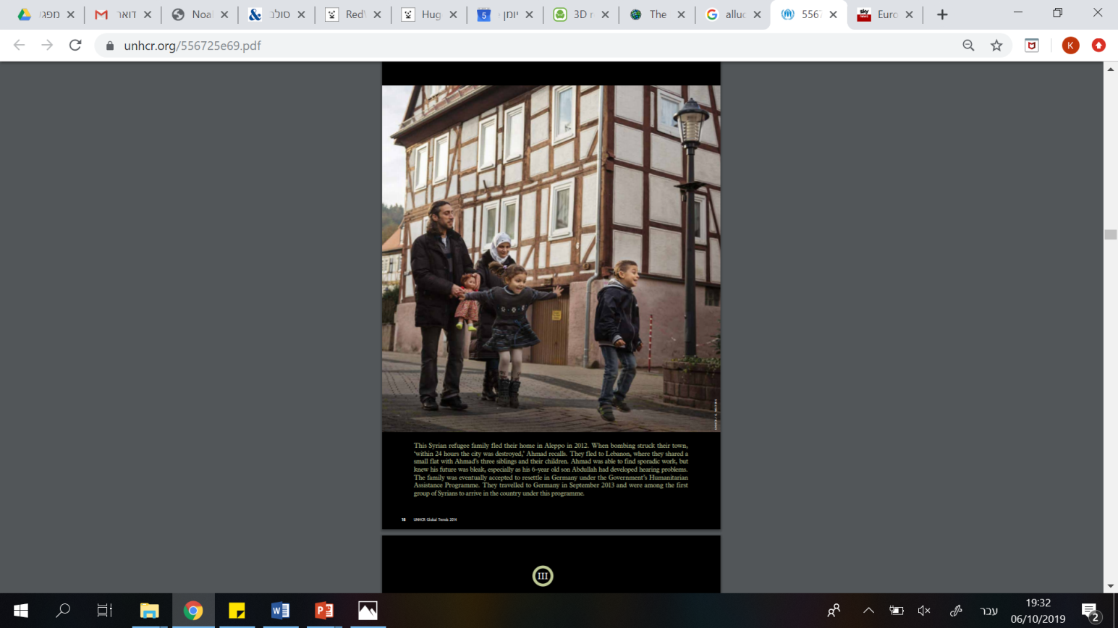
The Observable Phenomenon in Reality -
Migration to Europe
(Ontology)
Different interpretive concepts explain the observed phenomenon
(Epistemology)
Migration of Nations
Managed Refuge Issue
Working Migrants

Slide 14
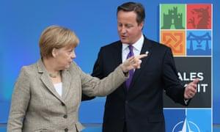

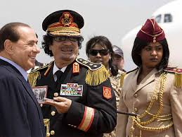
Environment
Understanding
Planning
Action
Current Lesson

Slide 15

Planning - The senior operating environment in which abstract ideas and logics are formulated and found, and processed into practical realization and execution abilities.
Environment
Understanding
Planning
Action
Current Lesson

Slide 16
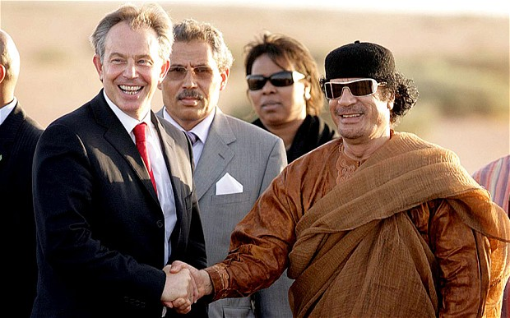
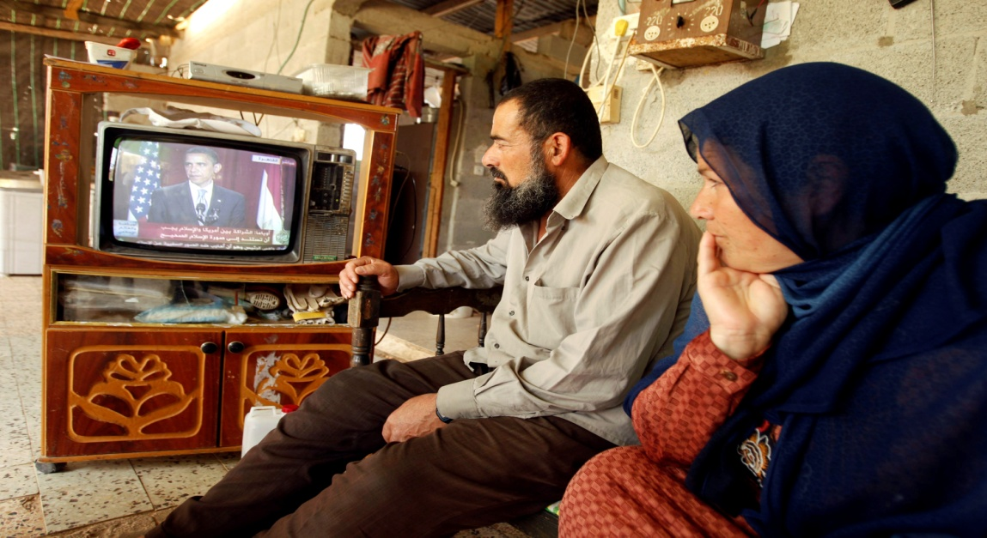
Materialism
“Experience Shapes Consciousness”
Dualism
Reality is both body and soul and the dialectic between them produces reality
Idealism
The capacity for change in the world lies in the power of the consciousness, thinking and conceptualization

Slide 17
Two Competing Approaches
"Go out and learn"
"Learning through action"
The centrality of interests
Understanding reality in context
The present will allow for future keys
"Think before you act"
"Planning is the focus"
The centrality of the vision
Making decisions according to planning
The future is important
The Golden Road

Slide 18
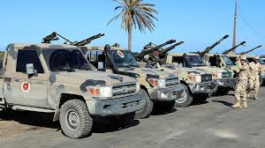
Strategy with Contradictions
(As Opposed to Linear Thinking)
Haftar forces in Libya
Gaddafi and Berlusconi
Europe actively supports the Kadhafi rebels since the outbreak of the civil war in Libya, for moral reasons
European support for Kadhafi (despite recognition of being an exporter of terror) in light of being a barrier between “Black Africa” and Europe's southern coast

Slide 19
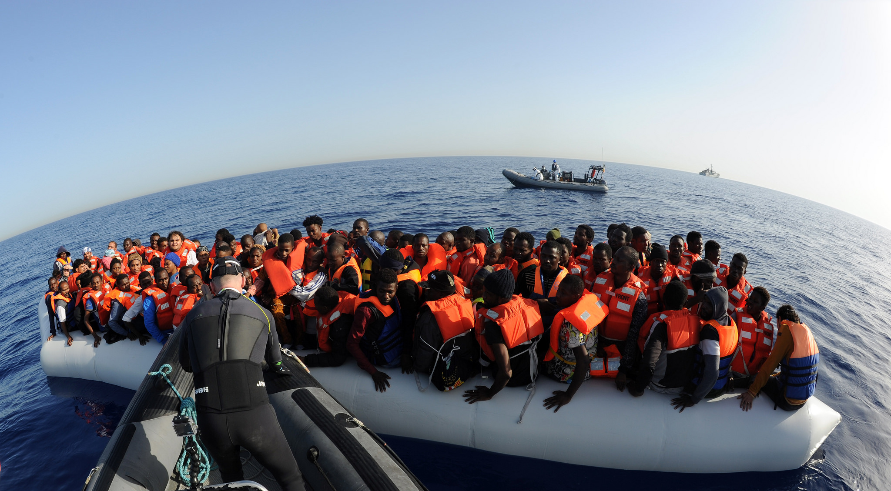
The Result (?)

Slide 20
Strategy - The science and art of designing a desired reality by continual and creative adaptation of tools and goals, based on a continuous effort to understand reality and action to realize the change needed to enforce our will on additional actors.
Environment
Understanding
Planning
Action
Action
Environment
Understanding
Planning
Action

Slide 21
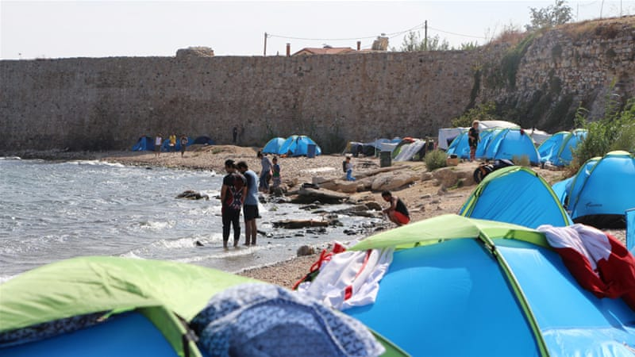
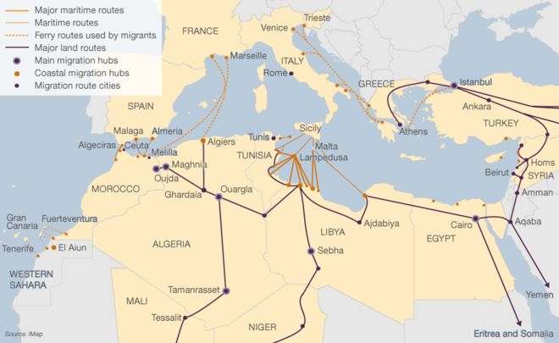
Environment
Understanding
Planning
Action
Coasts of Greece
Action
Environment
Understanding
Planning
Action

Slide 22
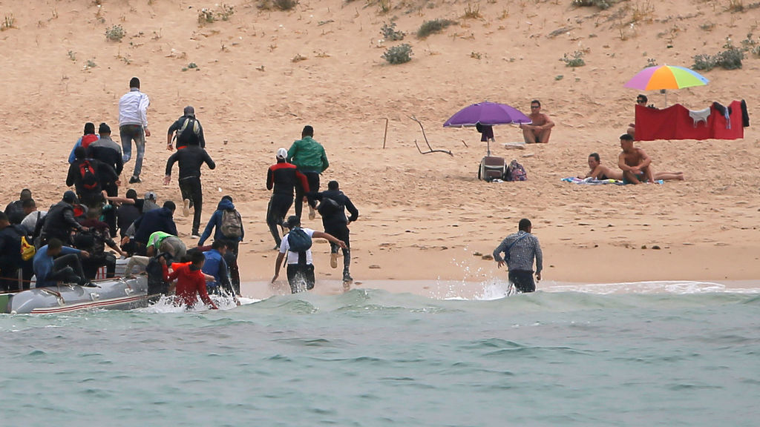
Environment
Understanding
Planning
Action
Coasts of Greece
Coasts of Spain
Action
Environment
Understanding
Planning
Action

Slide 23
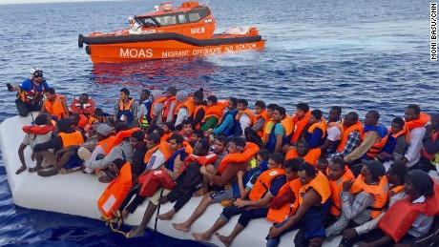
Environment
Understanding
Planning
Action
Action
Environment
Understanding
Planning
Action

Slide 24
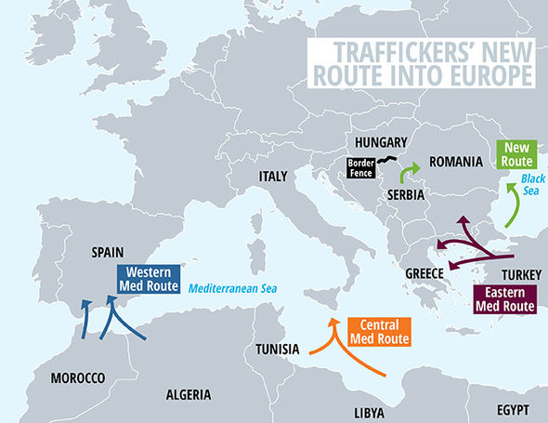
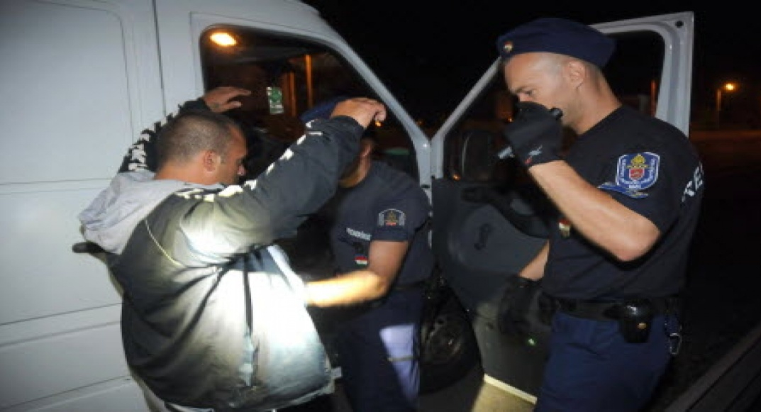
Environment
Understanding
Planning
Action
Action
Environment
Understanding
Planning
Action

Slide 25
The Idea of “the Middle” and the Process of Reaching it
The Parable of the Architect

Slide 26
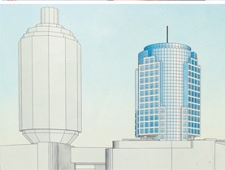
The entrepreneur has an unclear vision for the mall in the heart of Tel Aviv

Slide 27

The contractor specializes in the construction of stencils and the implementation of engineering programs

Slide 28
?
What allows on the one hand for the entrepreneur and his resources and the contractor on the other hand to become a functioning system and realize the full entrepreneurial potential?

Slide 29
The "Simple" Solution

Slide 30
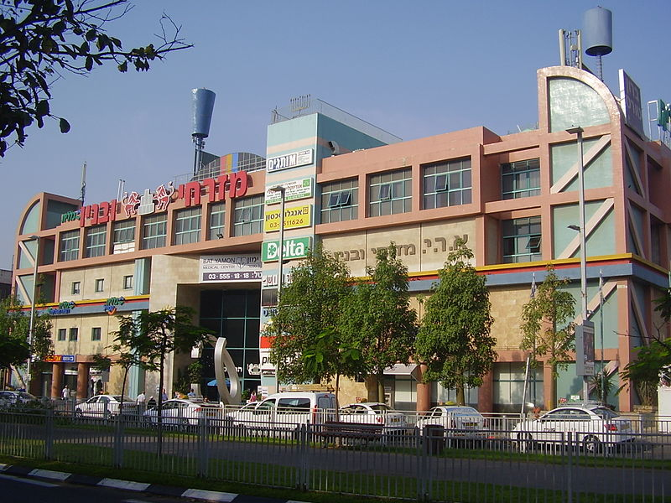
Simplistic and Technical Implementation

Slide 31
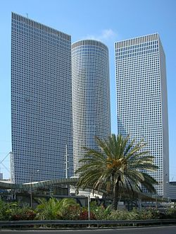
It is the architect who creates a perception - including a visual image - that links different levels of the entrepreneur and the contractor to realize the full potential embodied in the vision

Slide 32

Finding the middle - an interpretive and creative process that links essentially different elements, between the general strategy and the tactics, in order to transform them into a single system that is relevant in a unique context.
The Vision (Strategy)
The Campaign (“Middle”)
Tactics

Slide 33
And coming back to Europe ...

Slide 34
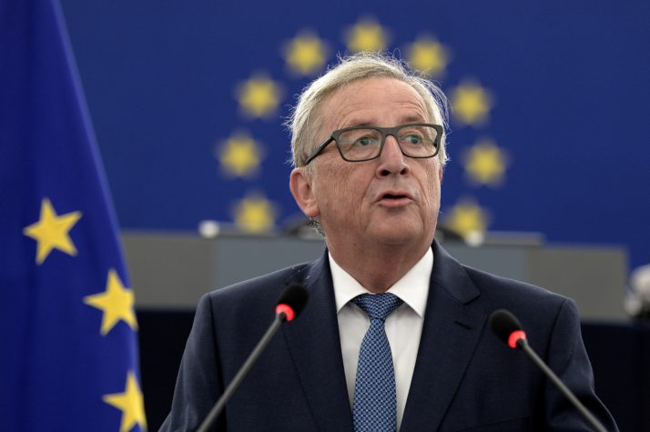
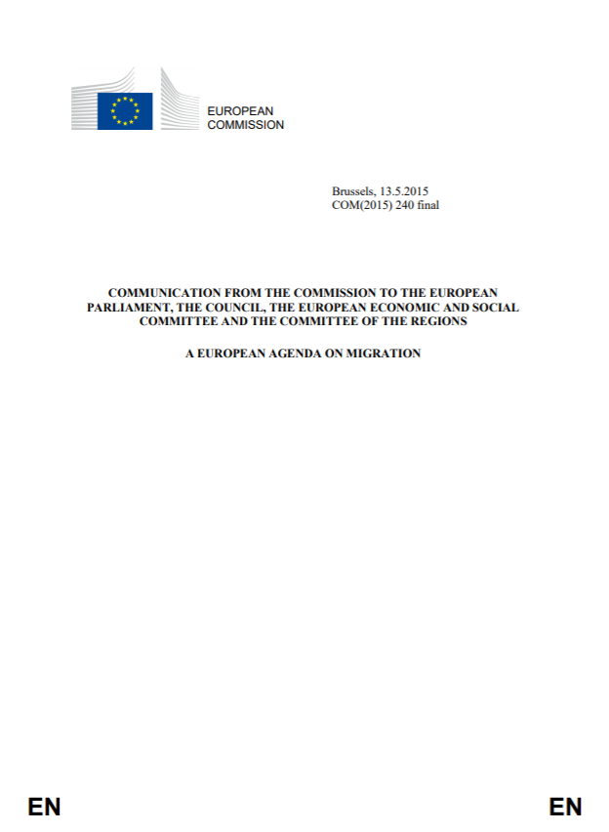

The Entrepreneur with the unclear vision
Jean-Claude Juncker, Head of the European Commission 2014-2019

Slide 35
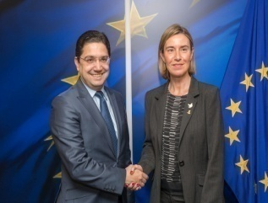
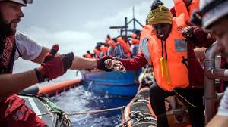
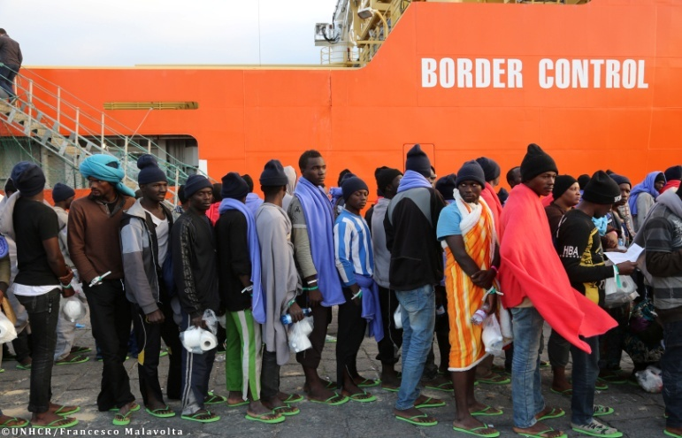
The Executive Level - Professional Experts

Slide 36
Is there a Middle for the European Test Case?
Relevancy
Reducing illegal immigration from Africa and the Middle East to Europe
Strategy
Strategy
Campaign
Campaign
Tactics
Tactics
Arrest of smugglers and collaborators
Transfer of intelligence to local security forces in Africa
Increasing the gathering resources on smuggling networks
Increase patrols along smuggling routes
Coherence

Slide 37

Reducing illegal immigration from Africa and the Middle East to Europe
Strategy
Campaign
Tactics
Arrest of smugglers and collaborators
Transfer of intelligence to local security forces in Africa
Increasing the gathering resources on smuggling networks
Increase patrols along smuggling routes

Slide 38
Summary to This Point
Planning
Understanding
Environment
The Middle and the Process of Finding it
Action (Intervention)

Slide 39
Strategy - The science and art of designing a desired reality by continual and creative adaptation of tools and goals, based on a continuous effort to understand reality and action to realize the change needed to enforce our will on additional actors.

