Slide 1



Israel Defense Forces Participants Information Booklet

Slide 2



Israel Defense Forces Commandant, National Defense College
The IDF and the United States of America share many of the same values and interests on the Regional and Global sphere.
Our shared values, since the founding of the State of Israel, and the deep roots of American Jewry, created a strong and strategic bond and alliance between our countries. Some may say that Israel is even the 51st state. Some may take this statement in light mind, but as a member of the IDF, and the General Staff, I know how crucial and deep our relationship is.
The cooperation between our counties touch each and every sector - from banking, investments, real estate, healthcare system, sports – and of course military and defense cooperation.
As our mil-to-mil cooperation grows, we realized we need to make sure that the IDF senior leadership understands and knows how the American system works, in order to ease the process of decision making and creating some sort of a common-language.
I would like to thank you all at JINSA for helping us execute this senior leadership seminar, and I look forward to learn and experience the American system, history, strategy and relationship with Israel with our friends and colleagues at JINSA.
Major General Itai Veruv
CG, IDF National Defense College

Slide 3



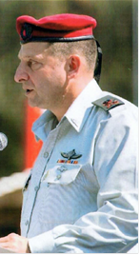

MG Itai Veruv
Commandant of the IDF Military Colleges
Military Service
Personal Info
CG, Gaza Division
CG, INDC
Born in 1966.
Married to Yael, Father to 6.
Resides in Maale Gilboa.
1985-2014
2014-2016
2016-2018
2019-
Enlisted to the "Tzanchanim" Paratrooper Brigade. Various Command & Staff Assignments
CoS, IDF Ground Forces
Education
B.A, Finance, BIU
M.A Political Science, University of Haifa
Mil Strategy in the UK RCDS
IDF National Defense College

Slide 4
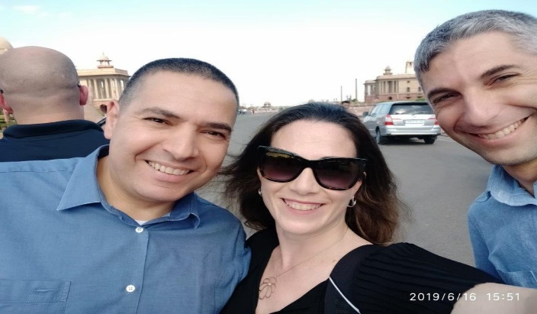
BG (S) Effie Defrin
Designated to Commander International Cooperation Unit
Military Service
Personal Info
Commander, 27th Brigade
Defense Attaché of Israel to India
BG (S) Effie Defrin is Married to Carmel and a father of four (Yuval, Ella, Yael, Alon).
1991-2011
2011-2014
2014-2015
2016-2019
Enlisted to the Armored Coprs. Various Command & Staff Assignments
Deputy Commander, 36th Division
Education
B.A, Social Science, Ben Gurion University
M.A, Security and Military Science, Hebrew University Jerusalem
JCSC, Advanced Staff and Command Course, British Military Shrivenham U.K

Slide 5
BG Yaron Finkelman
98th Division Commander
Designated to Head of Operations Division (DJ3)
Military Service
Personal Info
Commander of the Northern Gaza Brigade
Head of the Ground Forces HR Division
BG Finkelman is Married and a father of three.
1993-2013
2013-2015
2015-2017
2018-
Enlisted to Elite Air Force SOF. Various Command & Staff Assignments
Commander of the Givati Brigade
Education
B.A, Middle East Studies, Tel Aviv University
M.A, Diplomacy and Security, Tel Aviv University

Slide 6
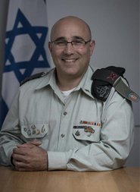
BG Ziv Avtalion
Head of the Ground Forces Technology Division
Designated Head of the upcoming Digital Transformation Division
Military Service
Personal Info
Head of the Combat Equipment Center
Head of the Ground Forces Technology Division
BG Ziv Avtalion was born in 1970 in Israel; he is married and has 4 children.
BG Avtalion currently resides in Pardes Hanah-Karkur.
1992-2014
2014-2016
2016-2017
2017-
Enlisted to the Armored Coprs. Various Command & Staff Assignments
Head of the TLD - Ground Forces Merging Management
Education
B.Sc., Mechanical Engineering,
The Israel Institute of Technology
M.A., Business Management, Bar-Ilan University
M.A., Political Science, University of Haifa
Alumnus of Public Administrative Studies,
Harvard University
IDF National Defense College

Slide 7
BG Avi Gil
Commander, 36th Division
Military Service
Personal Info
Head, IDF Officer Training School
Commander,
36th Division
BG Avi Gil was born in 1972.
He is married to Sharon and currently resides in Tel Aviv.
1990-2013
2013-2015
2015-2017
2017-
Enlisted to the "Tzanchanim" Paratrooper Brigade. Various Command & Staff Assignments
Commander,
340th Division
Education
LL.B (BA Law School), Interdisciplinary Center, Herzliya
M.A, Political Science, University of Haifa
IDF National Defense College

Slide 8
BG Dan Newman
Head of the Ground Forces Human Resources Division
& Designated 36th Division Commander
Military Service
Personal Info
Head of the Ground Forces Training Dept.
Head of the Ground Forces HR Division
BG Dan Newman is married to Kinneret, he is a father of three.
BG Newman currently Resides in Kibbutz ‘Chen’.
1991-2013
2013-2015
2015-2017
2017-
Enlisted to the Armored Corps. Various Command & Staff Assignments
Commander of the 7th Brigade
Education
LLB, Law & Business Management
M.A, History & Defense
M.A, National Security
IDF National Defense College

Slide 9
BG Eran Niv
Head of Judea and Samaria Division
Designated Head of Shiloach Division (J5)
Military Service
Personal Info
Head, IDF Officer Training School
Head of Judea and Samaria Division
BG Eran Niv is Married to Hagit and a father of three.
1989-2010
2010-2013
2014-2017
2017-
Enlisted to the "Tzanchanim" Paratrooper Brigade. Various Command & Staff Assignments
Head of Ground Forces HR Division
Education
B.A, Social Sciences, Bar Illan University
National Defense College
Royal College of Defense Studies (U.K)

Slide 10
RDML Eyal Harel
Head of Naval Intelligence (N2)
Military Service
Personal Info
Brigade Commanders Course, NDC
Head of Naval Intelligence
RDML Eyal Harel is Married and a father of three children.
1992-2013
2013-2015
2015-2017
2018-
Enlisted to Israeli Naval Academy. Various Command & Staff Assignments
Head of Planning Department,
IDF J-5
Education
B.A, Economics and Business Administration
M.A, Political Science, University of Haifa
National Defense College

Slide 11
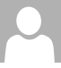
Brig. Gen. Amit Gat
Director of Israel Air Force Intelligence (A2)
Military Service
Personal Info
Head, Strategic Planning Dept. (J5)
Director of Israel Air Force Intelligence (A2)
Brig. Gen. Amit Gat is Married to Gali and a father of three.
1991-2013
2013-2015
2015-2018
2018-
Enlisted to IAF as a Cargo Pilot. Various Command & Staff Assignments
Commander, Sde Dov AFB
Education
B.A, Electrical Engineering, Tel Aviv University
M.A, Political Science, Tel Aviv University

Slide 12
BG Eran Ortal
Head of the Dado Center for Interdisciplinary Military Studies
Military Service
Personal Info
Head of System Analytics Branch, IDF J5
Head of the Dado Center for Interdisciplinary Military Studies
BG Eran Ortal was born in September 22nd, 1971 in Tel Aviv-Jaffa.
He currently resides with his wife Perla and four children in Matan, a town in the center of Israel.
1989-2010
2010-2012
2013-2019
2019-
Enlisted to Field Reconnaissance Brigade. Various Command & Staff Assignments
Head of Research Team, Dado Center for Interdisciplinary Military Studies
Education
B.A in History and Political Science, Open University of Israel
M.A in Military Studies, Tel Aviv University
IDF National Defense College

Slide 13
COL Amit Saar
Chief Intelligence Officer, Southern Command
Designated to Head of Research Division
Military Service
Personal Info
Head of the CT Branch, Southern Command
Chief Intelligence Officer, Southern Command
Designated to Head of Research Division
COL Saar is Marreid to Alal.
He is a father of two (Omer – 3.5 & Amos – 1.5).
1990-2013
2013-2015
2015-2017
2018-
Various positions in the IDI
Head of the Palestine Division, IDI Research Division
Education
M.A in Philosophy,
Hebrew University Jerusalem
M.A in Conflict Resolution, Brandeis University
M.A in Political Science, University of Haifa
IDI Cross – Organizational Intelligence Course
IDF National Defense College

Slide 14
COL Erez Askal
Head of 9900 Unit (GEOINT)
Military Service
Personal Info
Chief Intelligence Officer
Judea & Samaria Division
Head of 9900 Unit (GEOINT)
COL Erez Askal was born in 1977.
COL Askal is married and a father of four.
He currently resides in Beit Gamliel.
1989-2010
2015-2017
2017-2019
2019-
Enlisted to ‘Nahal’ Brigade. Various Command & Staff Assignments (A2)
IDI, Northern Branch
Education
B.A in Law, Ono Academic College
M.A in Political Science (Middle East & Africa), Tel Aviv University

Slide 15
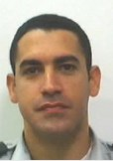
COL Gil Pinchas
Designated to the head of IMOD Budget Directorate & The Office of the Financial Advisor to IDF CHOD
Military Service
Personal Info
Head of Planning Department
Various Economic & Staff Assignments
COL Gil Pinchas was born in 1980.
Married to Daphne and currently Resides in Tel - Aviv
1989-2010
2015-2017
2018-
Head of Macroeconomics and Research Branch
Education
B.A in Economics & Management, University of Haifa
M.B.A, Technion, Israel Institute of Technology, high Tech Firms Management
P.h.D, Strategy, Tel-Aviv University

Slide 16
Dr. COL Hadas Minka-Brand
Head of IDF Behavioral Sciences Center
Military Service
Personal Info
Head of Organizational Development, 8200 Unit (J-2)
Head of IDF Behavioral Sciences Center
Dr. COL Hadas Minka-Brand resides in Jerusalem.
She is Married and a mother of three.
1994-2011
2011-2015
2015-2017
2017-
Various field and staff positions
Head of Behavioral Sciences, J-2
Education
M.A in Labor Studies
PhD, Organizational Sociology, Tel Aviv University

Slide 17
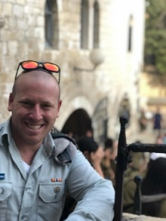
MAJ Benzi Zimmerman
Head of J3 International Cooperation Desk
Military Service
Personal Info
Desk Officer, Intl. Cooperation Unit
Head of J3 International Cooperation Desk
MAJ Benzi Zimmerman resides in Jerusalem, he is married to Samantha and the father of Cayli.
2010-2013
2013-2015
2015-2017
2018-
Various field NCO and staff positions
Chief Ops Officer, IDF J5
Education
B.A, International Relations, Bar Ilan University
M.A, Political Science & Political Communications, IDC

