Slide 3
https://www.gartner.com/en/information-technology/glossary/digital-transformation

Slide 5
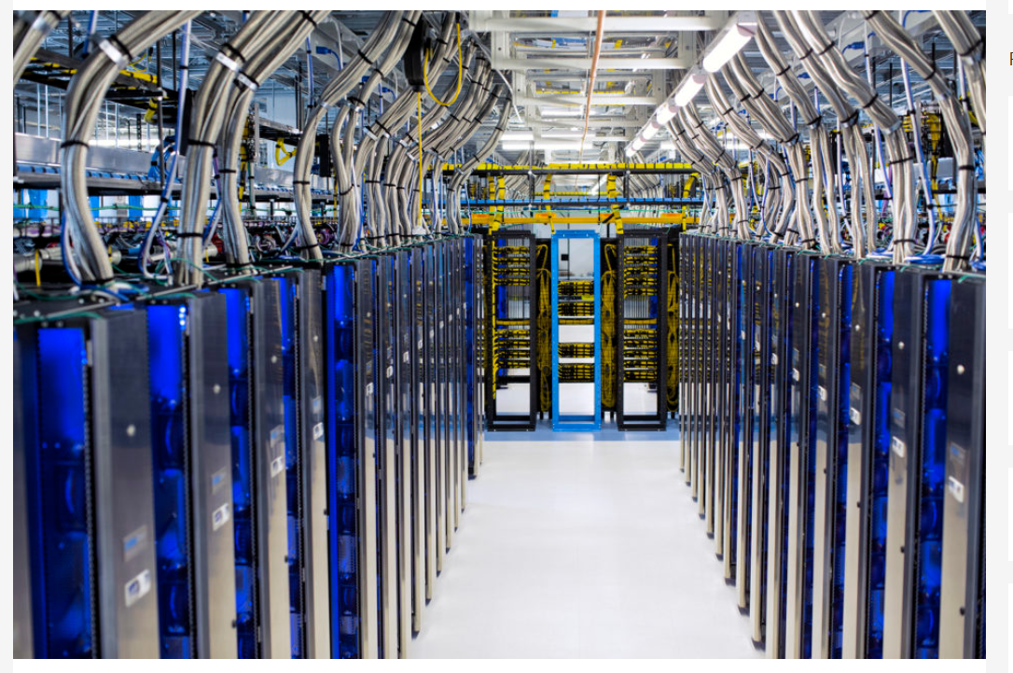
Introducing to Cloud Computing

Slide 6
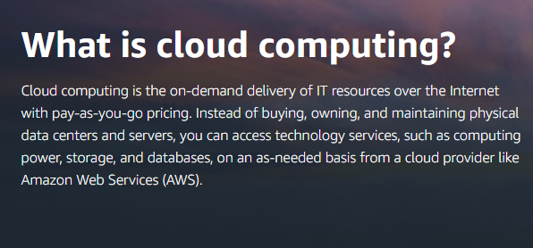
https://aws.amazon.com/what-is-cloud-computing

Slide 7
https://azure.microsoft.com/en-us/overview/what-is-the-cloud/

Slide 8
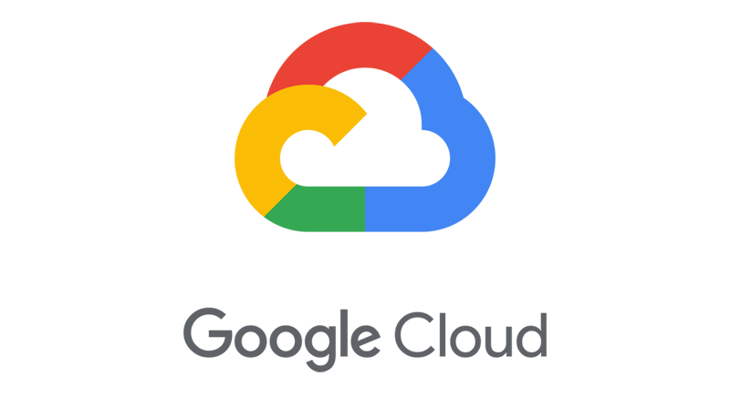
https://cloud.google.com/learn/what-is-cloud-computing

Slide 9
https://www.salesforce.com/products/platform/best-practices/cloud-computing/
Essentially, cloud computing is a kind of outsourcing of software, data storage, and processing. Users access applications and files by logging in from any device that has an internet connection. Information and programs are hosted by outside parties and reside on a global network of secure data centers instead of on the user’s hard drive. This frees up processing power, facilitates sharing and collaboration, and allows secure mobile access regardless of where the user is or what device is being used.
Cloud computing is a more efficient way of delivering computing resources. With cloud computing, software and service environments are subscription-based — users pay a monthly fee instead of buying licenses. Software and platforms are managed by the providers and are updated continuously for maximum performance and security. Computing power is remote instead of centralized, so users can tap into extra capacity if business spikes. Multiple people can access a shared program or file and collaborate in real time from different locations.

Slide 10
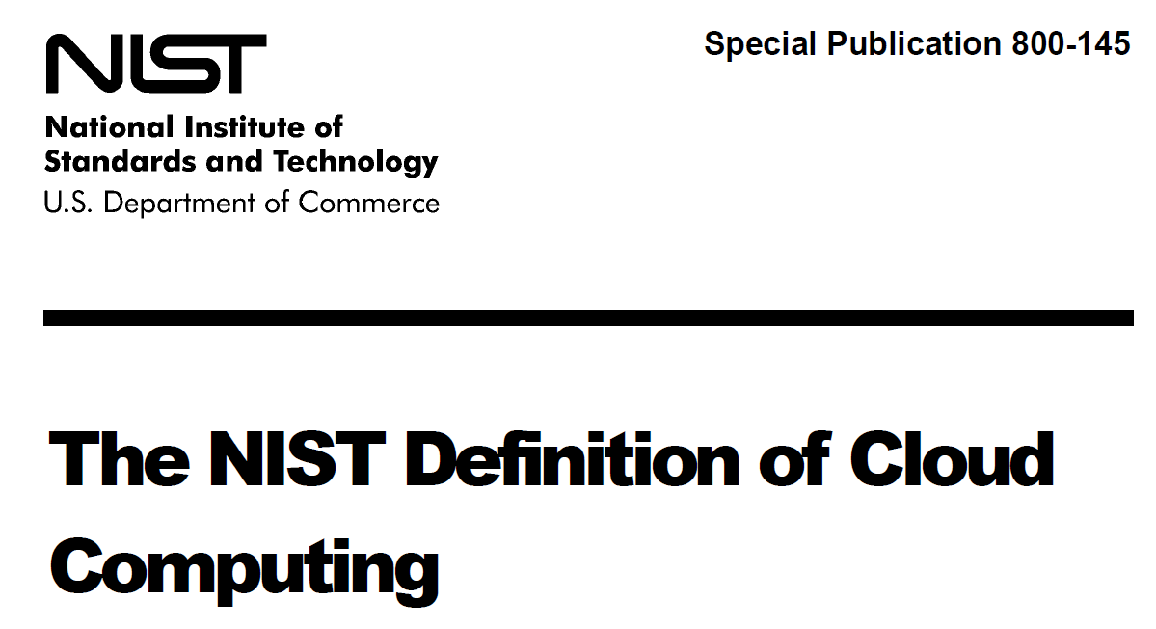

Slide 11
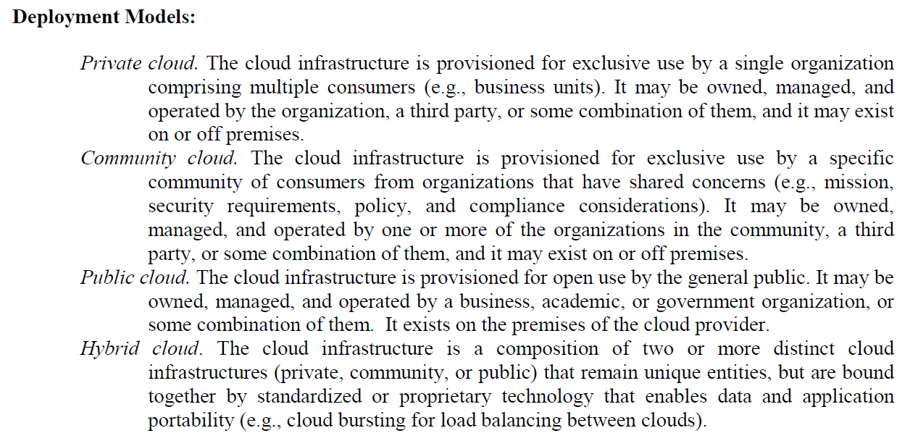

Slide 12
Service Models
Cloud Computing Models

Slide 15
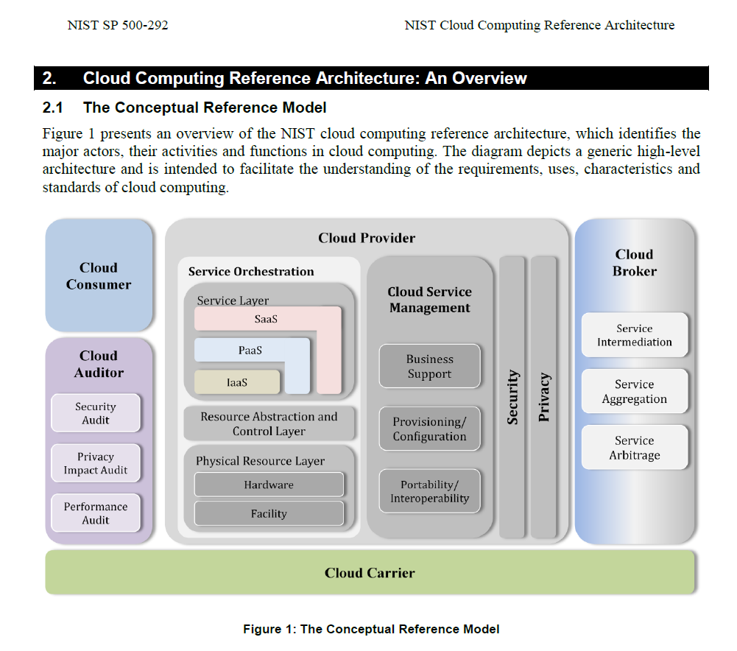

Slide 16
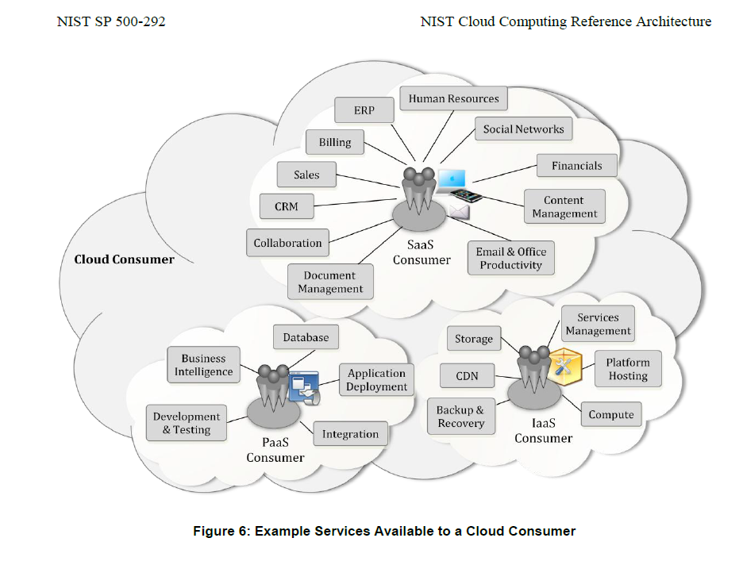

Slide 17
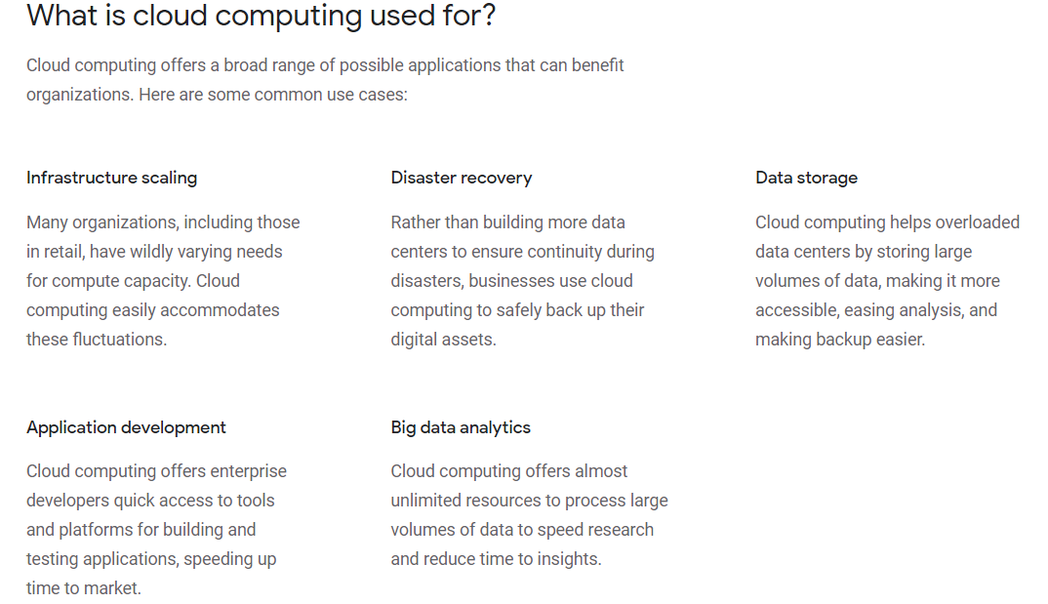
https://cloud.google.com/learn/what-is-cloud-computing

Slide 18
Advantages and Disadvantages of Cloud Computing

Slide 20
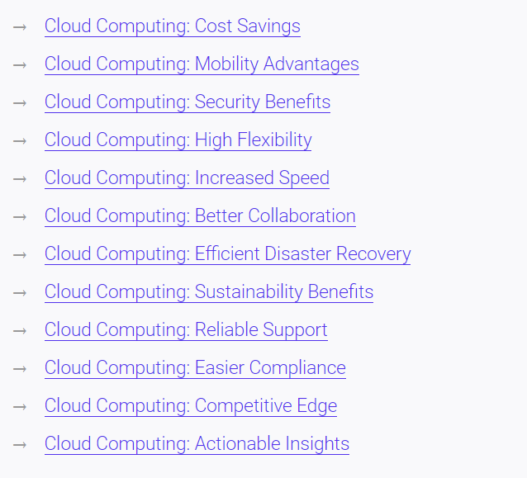

Slide 22
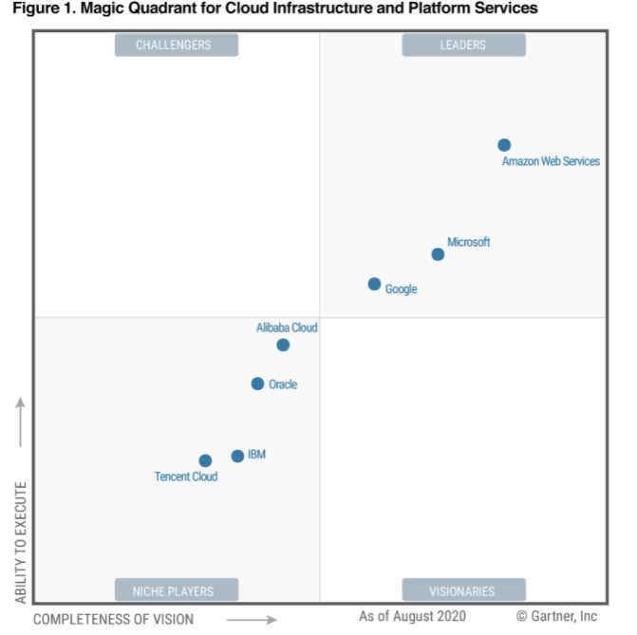
Market View

Slide 23
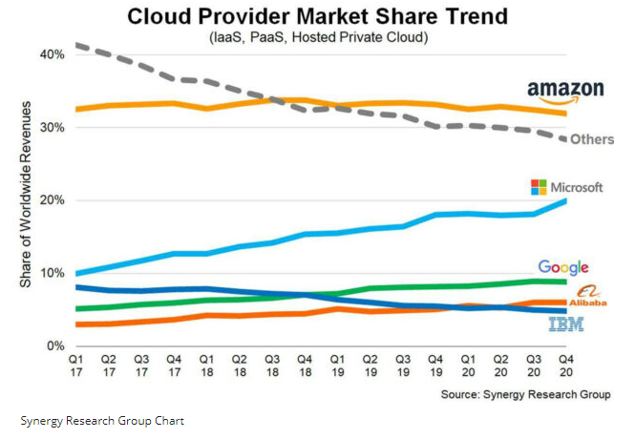

Slide 24
Shared responsibility model

Slide 25
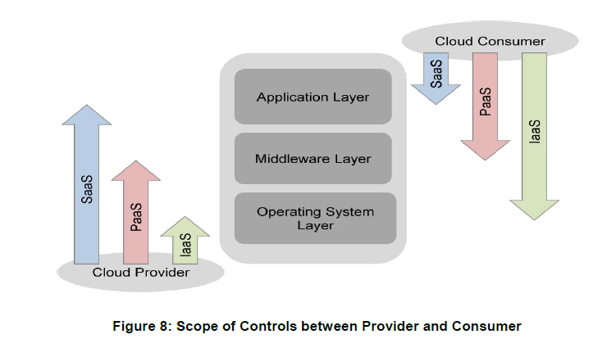

Slide 27
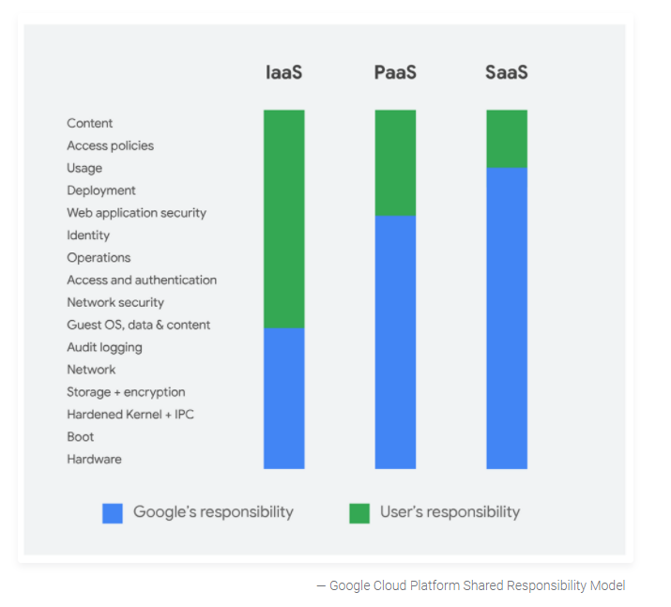

Slide 28
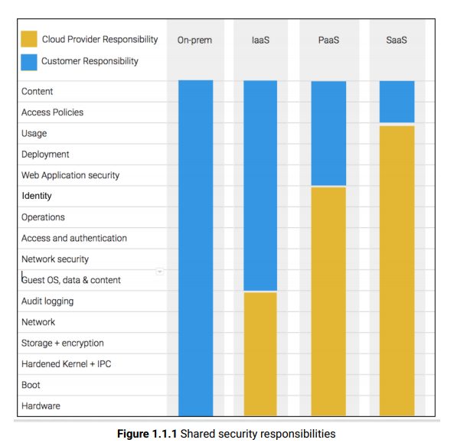
Google Cloud

Slide 29
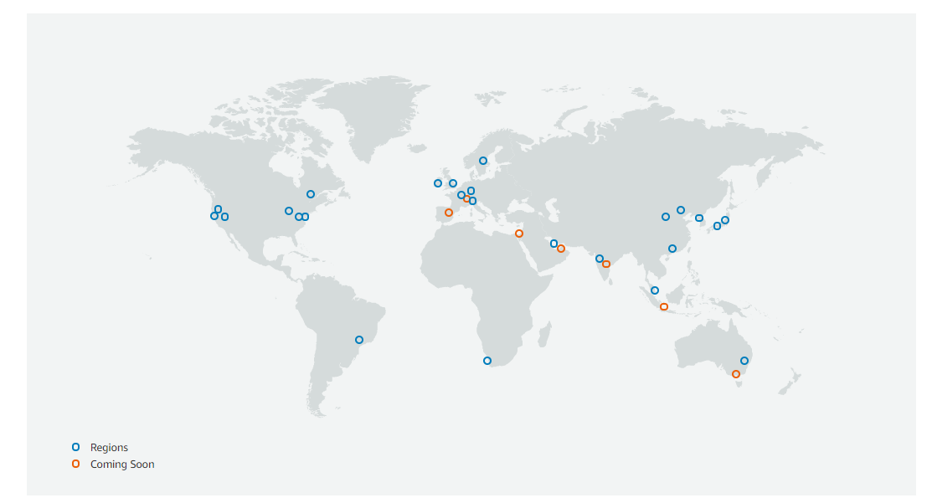
Global Infrastructure
https://aws.amazon.com/about-aws/global-infrastructure/

Slide 30
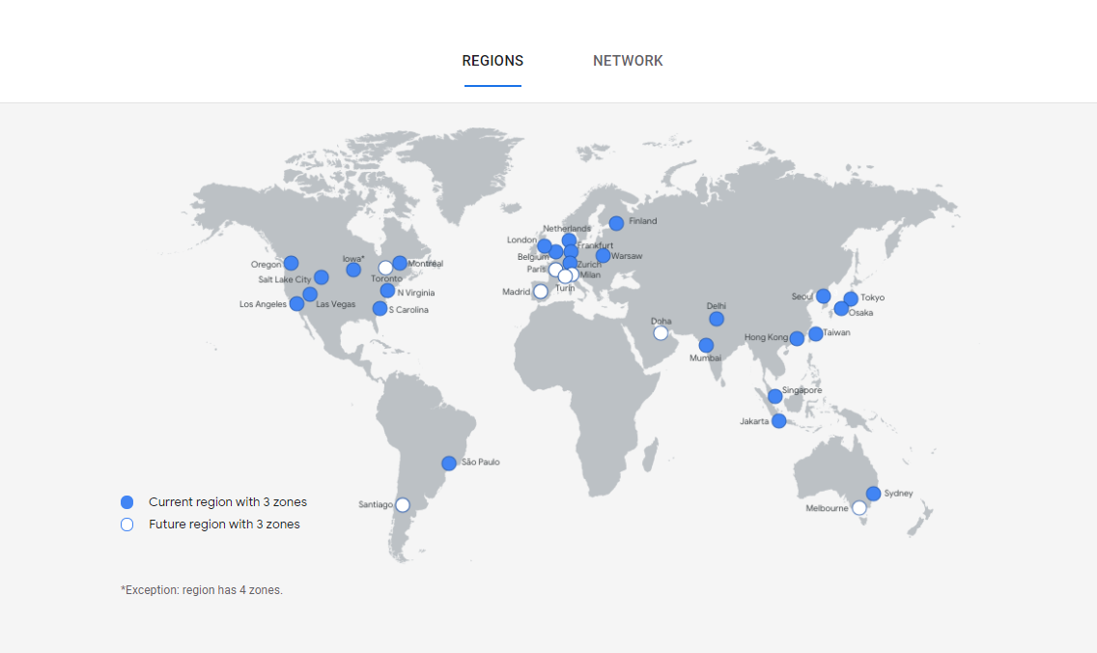
Cloud locations
https://cloud.google.com/about/locations

Slide 31
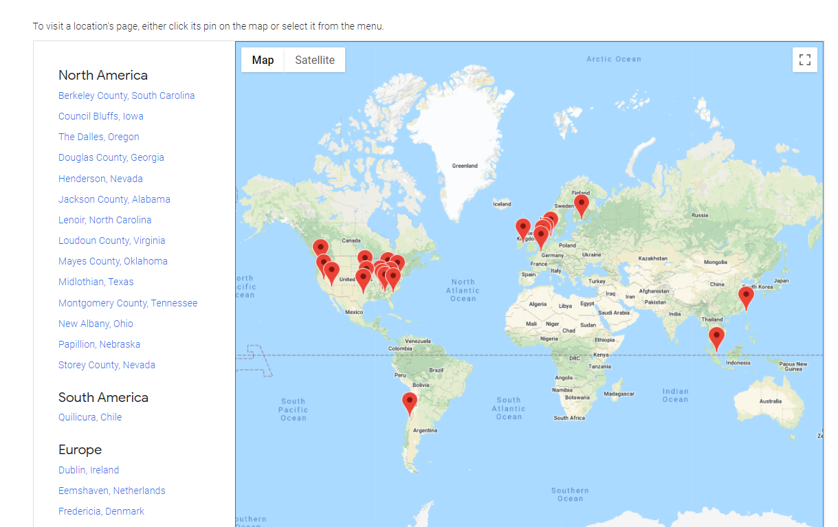
Data Centers

Slide 32
GCP
Each data center location is in a region. Regions are available in Asia, Australia, Europe, North America, and South America. Each region is a collection of zones, which are isolated from each other within the region. Each zone is identified by a name that combines a letter identifier with the name of the region. For example, zone a in the East Asia region is named asia-east1-a

Slide 33
https://cloud.google.com/about/locations

Slide 34
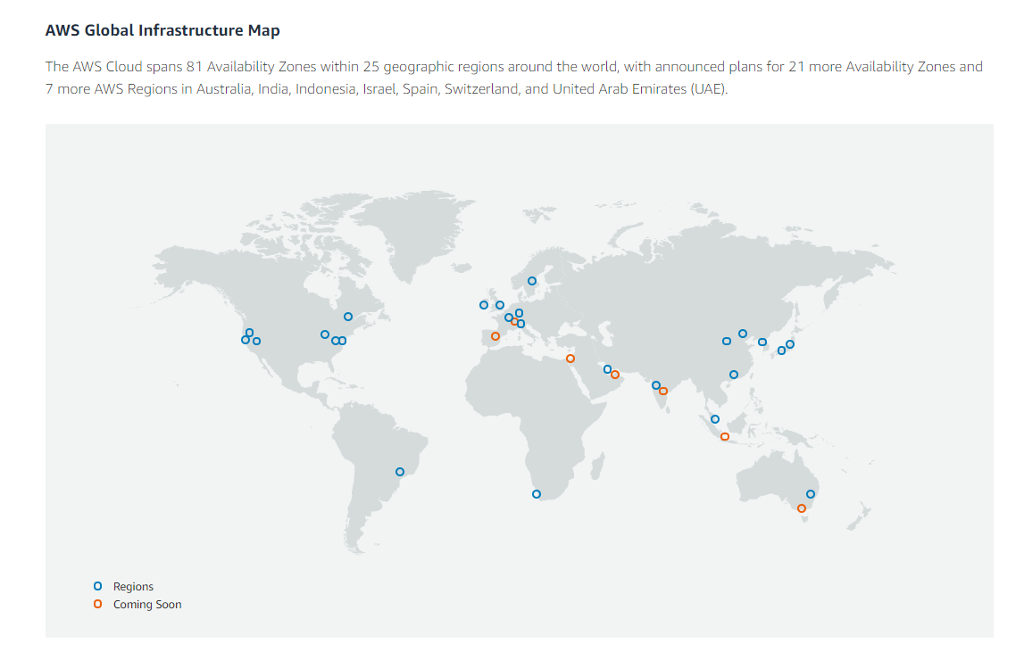
https://aws.amazon.com/about-aws/global-infrastructure/

Slide 35
https://peering.google.com/#/infrastructure

Slide 36
Securing the cloud

Slide 37
Top Threats to Cloud Computing The Egregious 11

Slide 39
https://kinsta.com/blog/cloud-security/

Slide 40
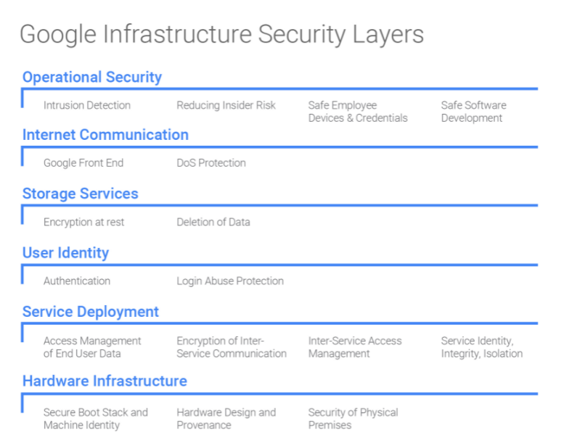

Slide 41
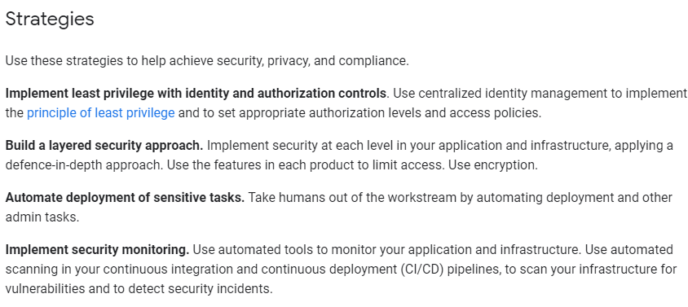
Security, privacy, and compliance
https://cloud.google.com/architecture/framework/security-privacy-compliance

Slide 42
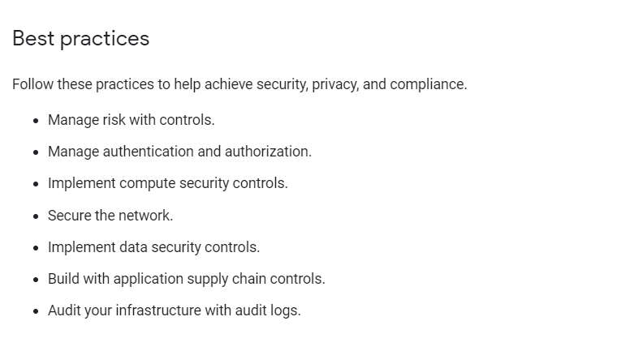

Slide 43
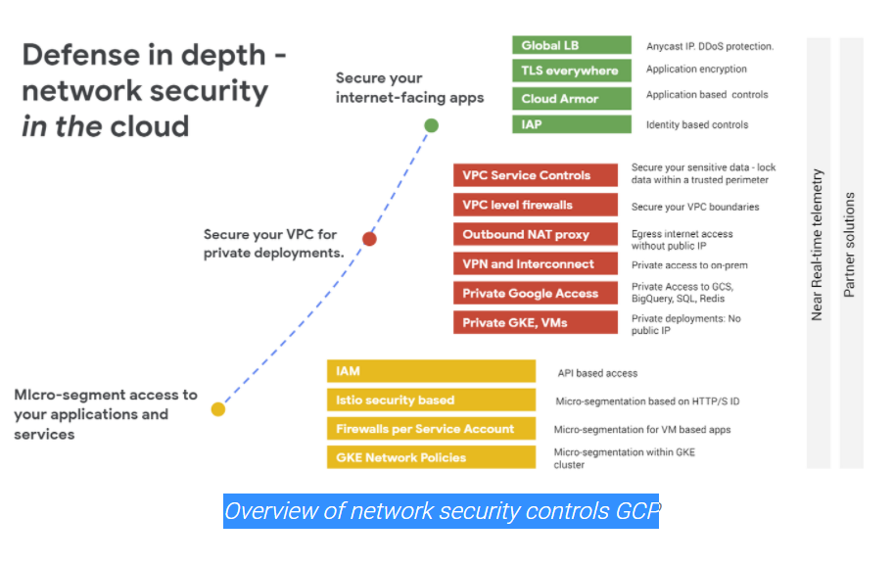

Slide 44
Security cloud computing
https://cloud.google.com/security/compliance
https://attack.mitre.org/
https://cloud.google.com/security/compliance/offerings
https://cloud.google.com/blog/topics/inside-google-cloud/cloud-computing-101-frequently-asked-questions

Slide 45
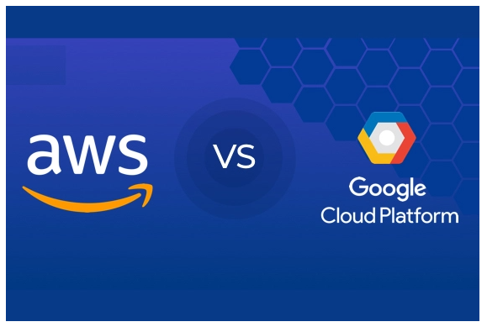
https://www.guru99.com/google-cloud-vs-aws.html
https://www.eweek.com/cloud/aws-vs-google-cloud-platform/

Slide 46
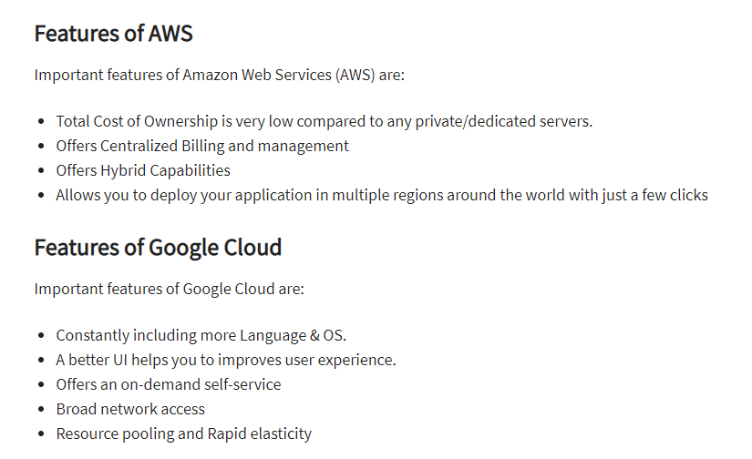
The pros/benefits of selecting Google cloud services:
Offers higher productivity gained through Quick Access to innovation
Employees can work from Anywhere
Future-Proof infrastructure
It provides a serverless environment which allows you to connect cloud services with a large focus mainly on the microservices architecture.
Offers Powerful Data Analytics
Cost-efficiency due to long-term discounts
Big Data and Machine Learning products
Offers Instance and payment configuration

Slide 47
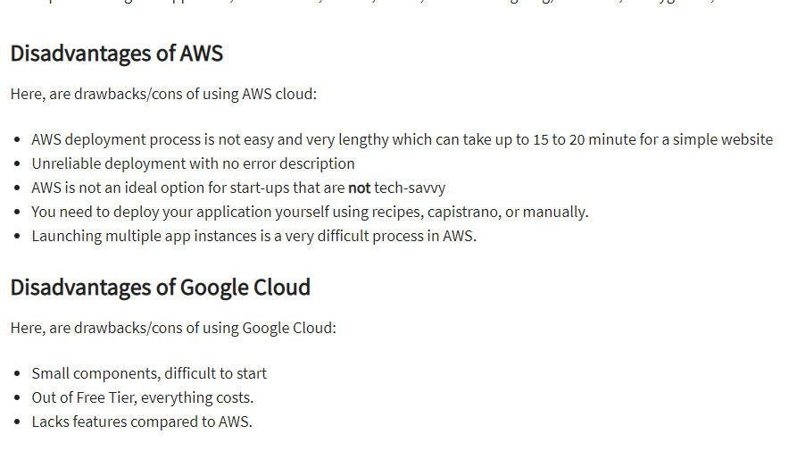

Slide 48
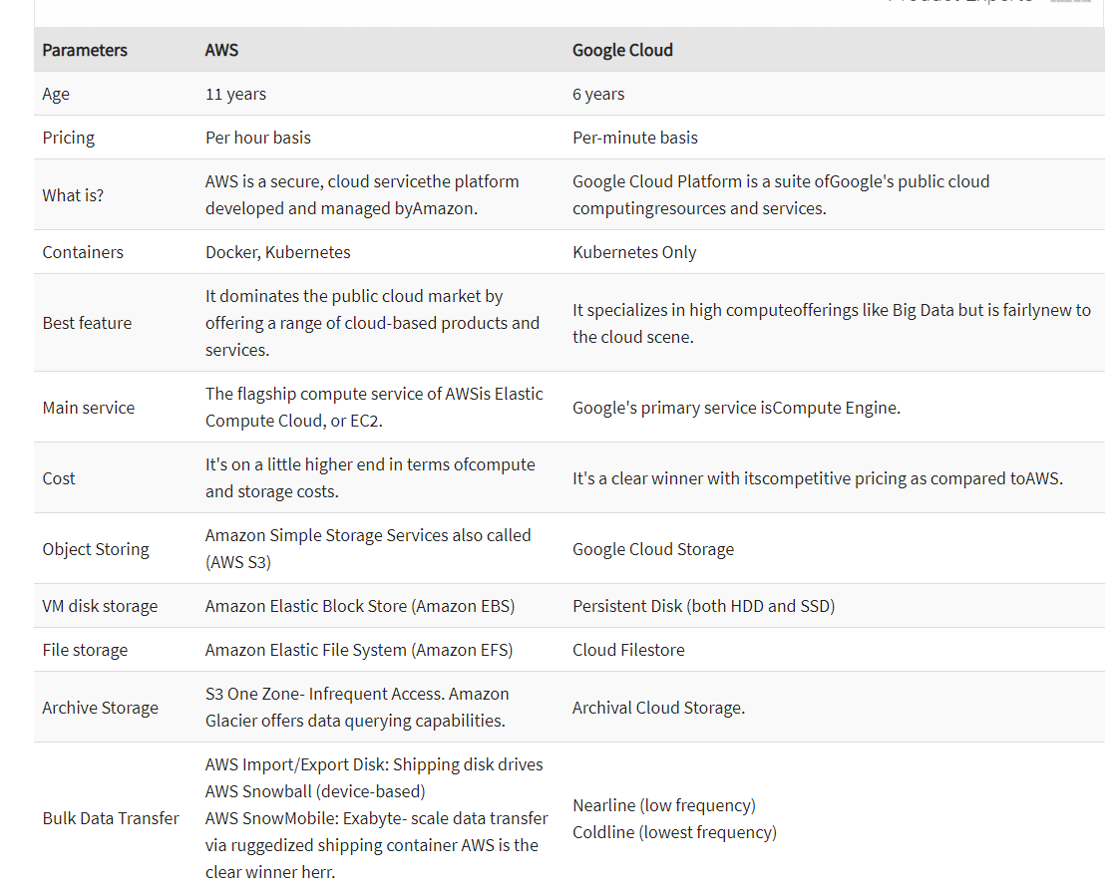

Slide 49
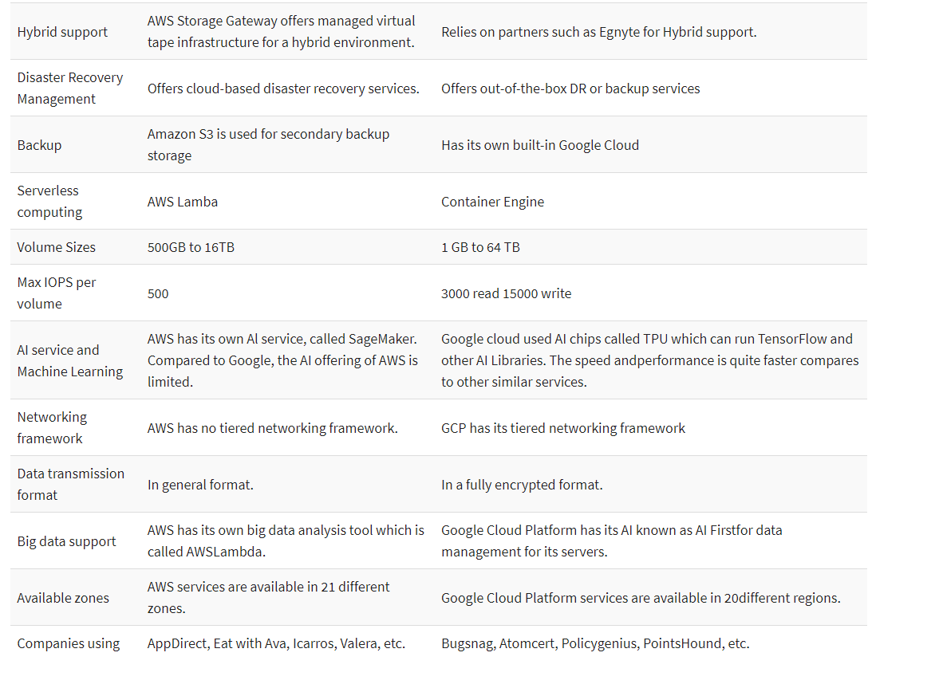

Slide 50
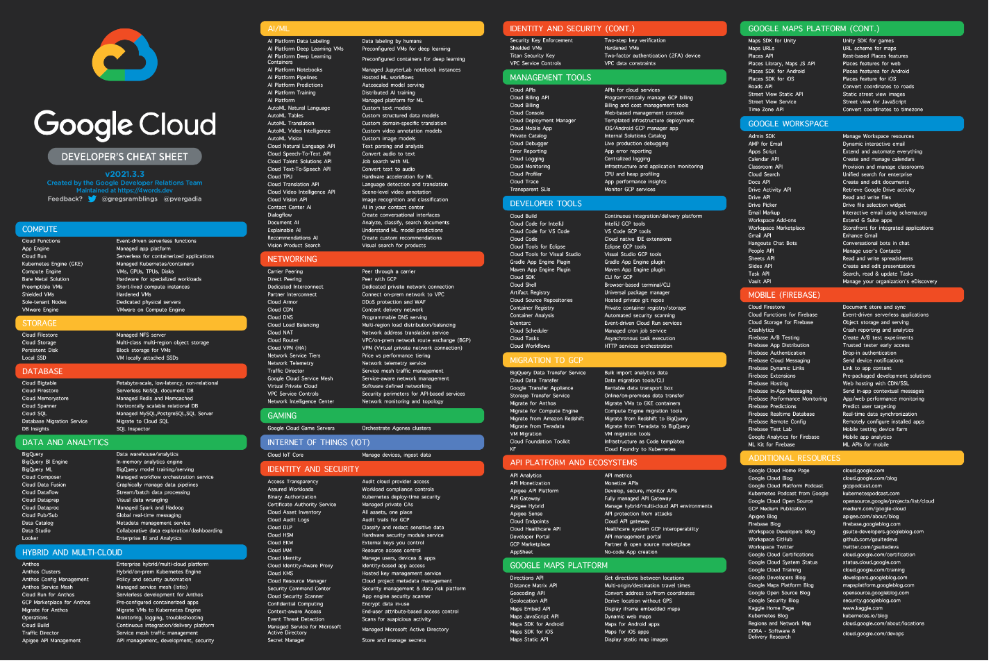
Google Cloud products
https://raw.githubusercontent.com/gregsramblings/google-cloud-4-words/master/DarkPoster-lowres.png

Slide 51
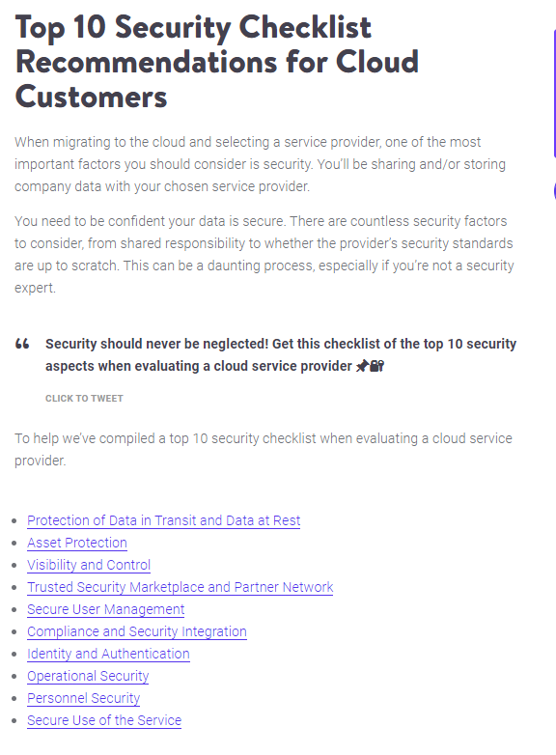

Slide 52
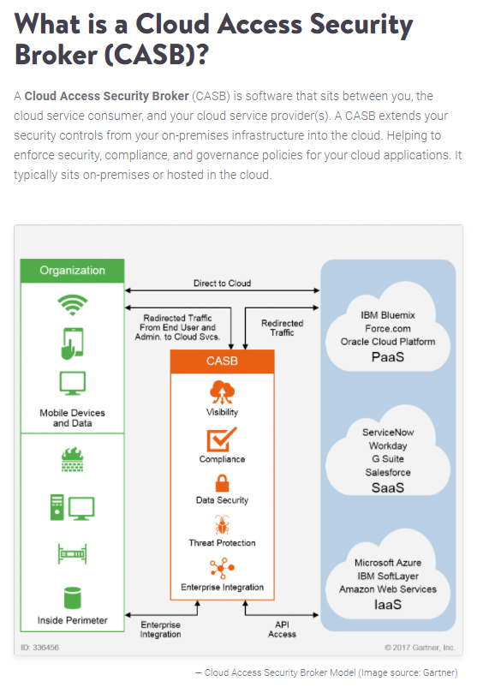

Slide 53
Security, privacy, and compliance
https://cloud.google.com/architecture/framework/security-privacy-compliance

Slide 54
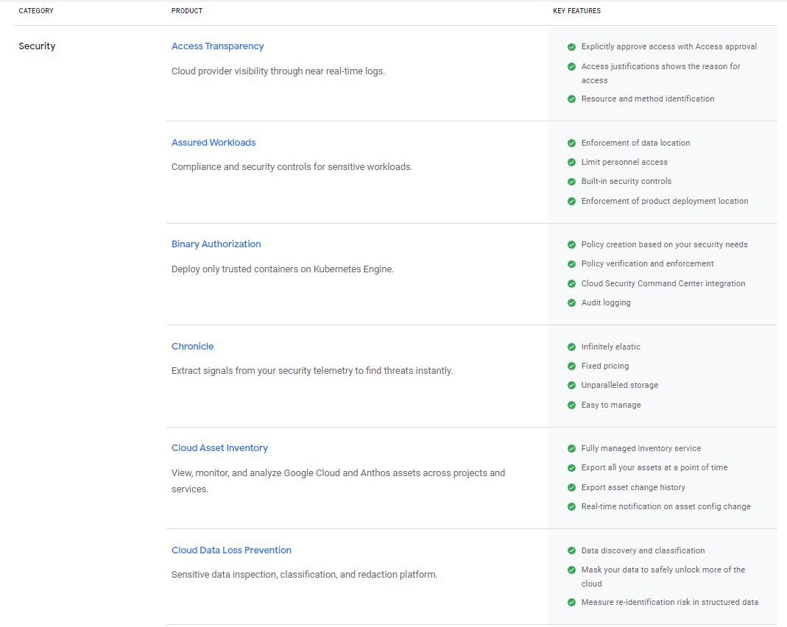

Slide 55
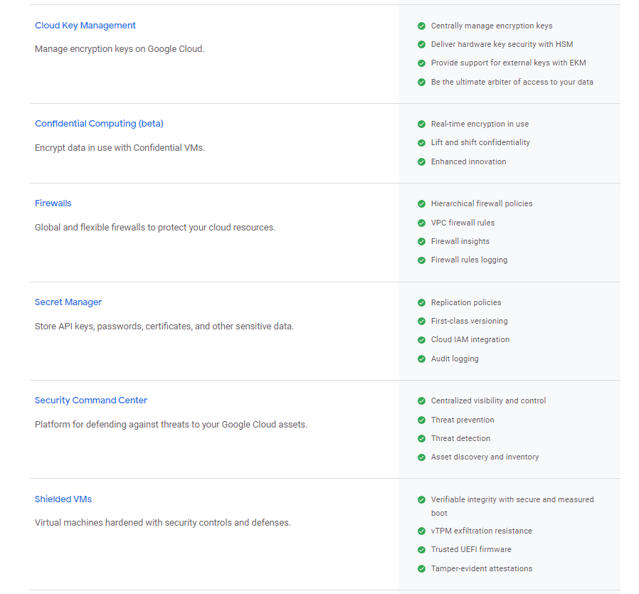

Slide 56
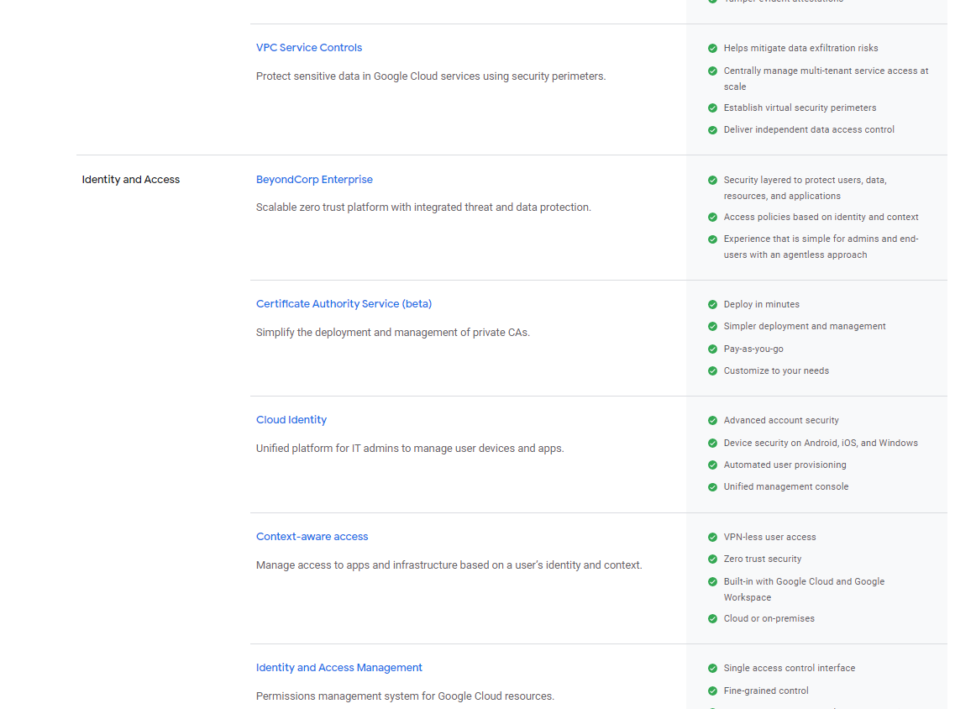

Slide 59
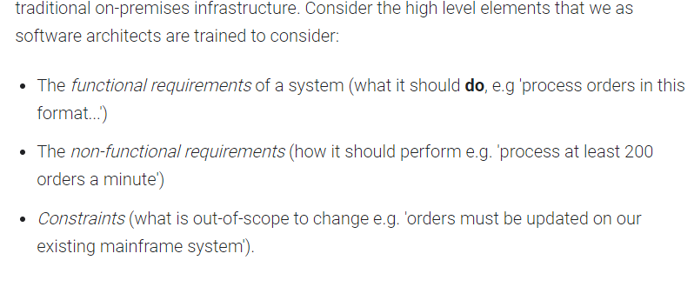

Slide 60
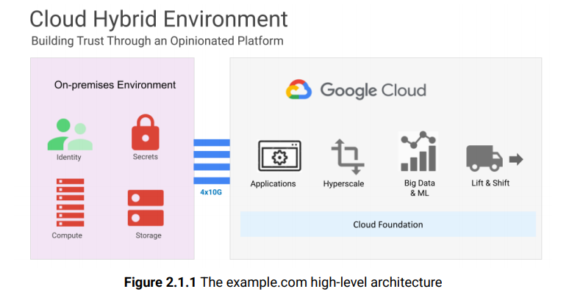

Slide 61
https://cloud.google.com/free/docs/aws-azure-gcp-service-comparison

Slide 62
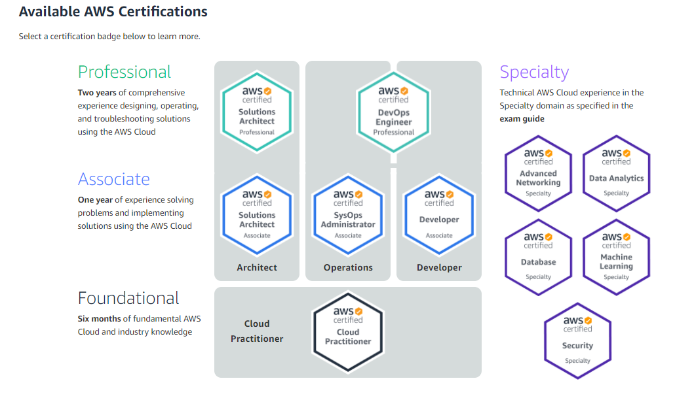

Slide 63
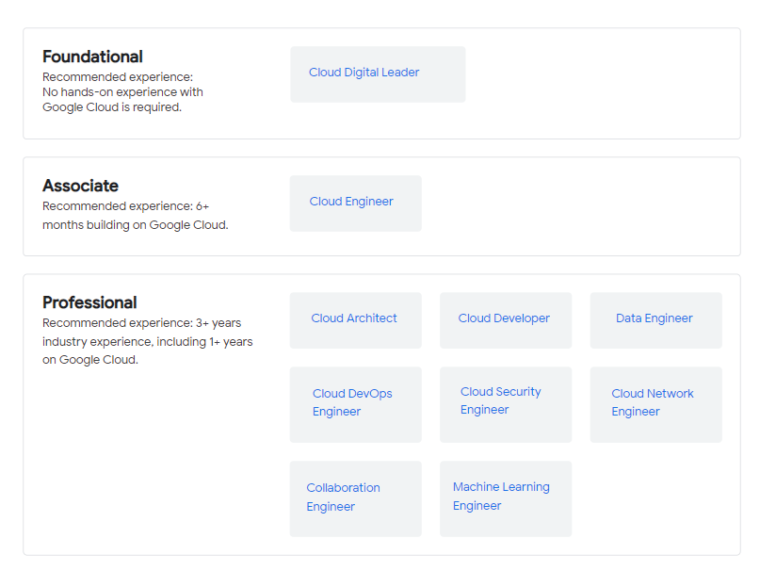
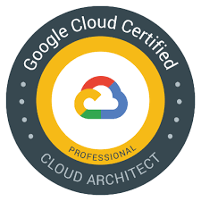

Slide 64
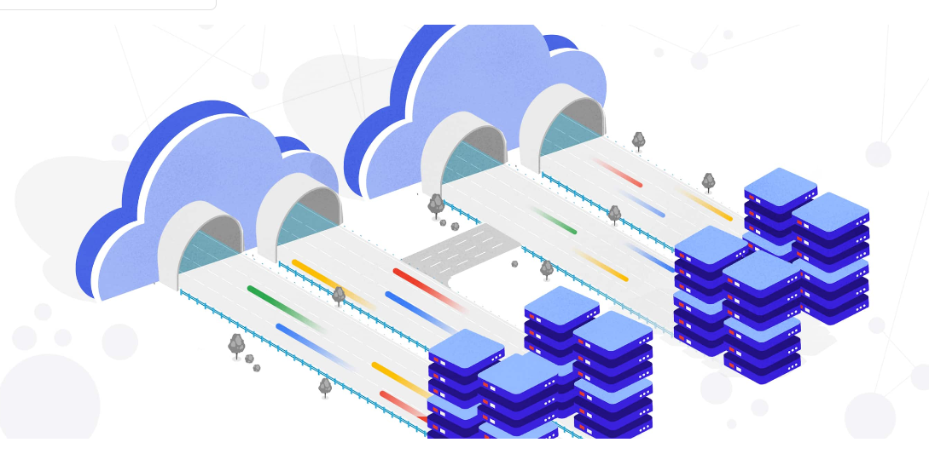
How to migrate an enterprise workload into the cloud

Slide 67
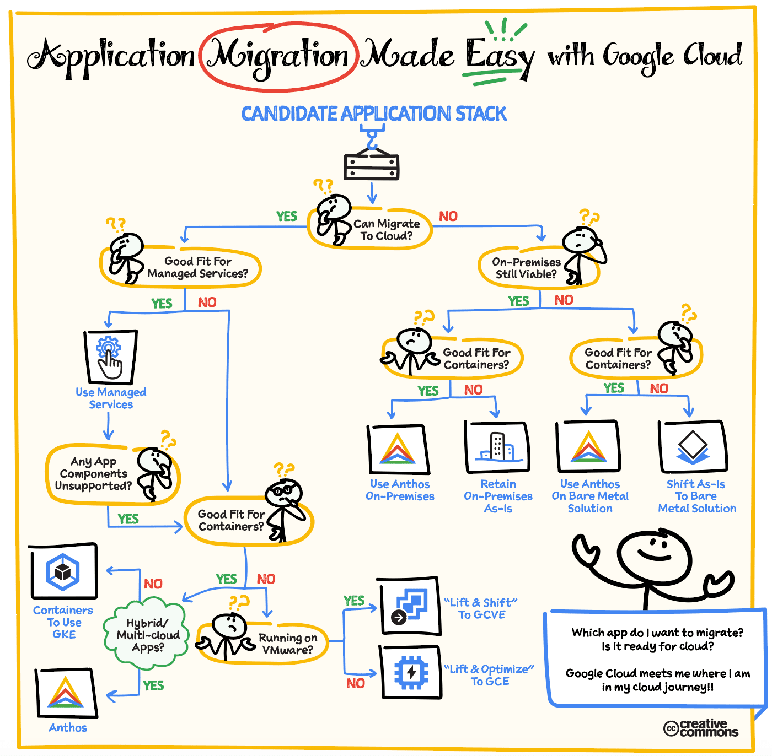
https://cloud.google.com/blog/topics/developers-practitioners/google-cloud-migration-made-easy

Slide 68
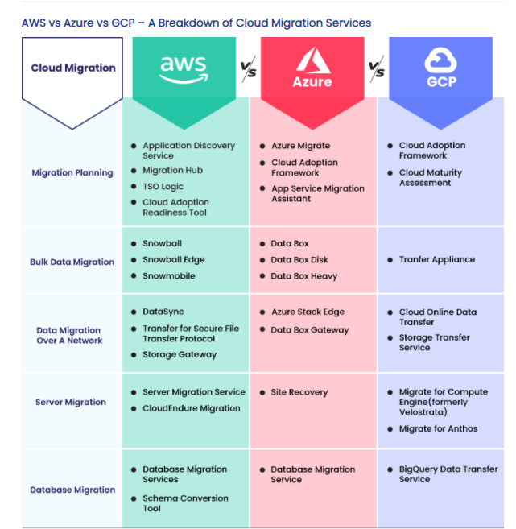
https://www.veritis.com/blog/leverage-full-advantage-of-cloud-migration-with-gcp/

Slide 69
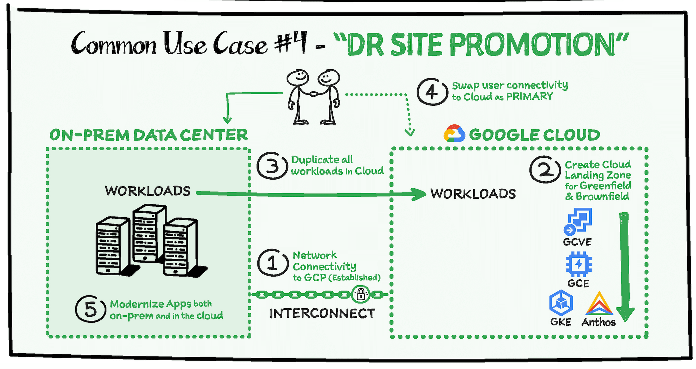

Slide 70
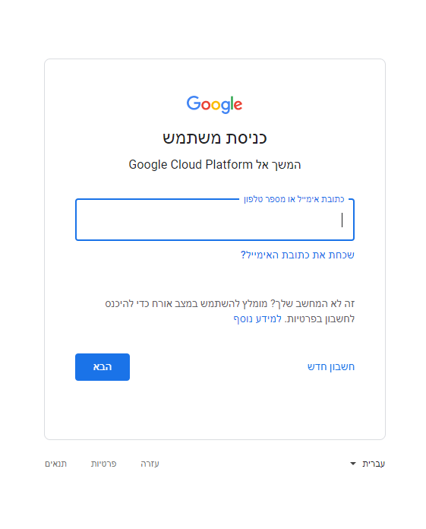
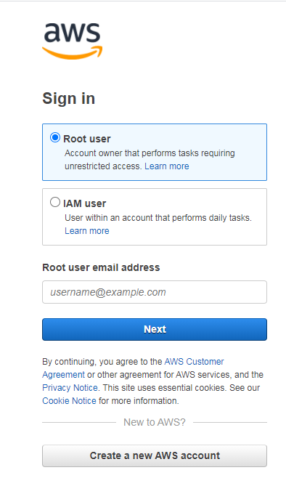
אז איך זה נראה הלכה למעשה?

Slide 71
SOLUTION ICONS FOR ARCHITECTURAL DIAGRAMS
https://cloud.google.com/icons
https://app.diagrams.net/?splash=0&libs=gcp

Slide 72
Google Cloud overview
https://cloud.google.com/docs/overview
understand the overall landscape of Google Cloud

Slide 73
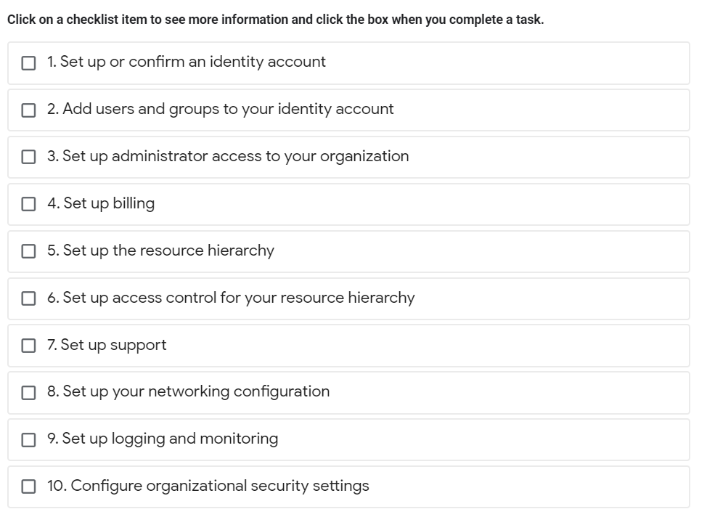
Google Cloud setup checklist
https://cloud.google.com/docs/enterprise/setup-checklist

Slide 74
Cloud Architecture Center
https://cloud.google.com/architecture

Slide 75
https://calculator.aws/#/

Slide 76
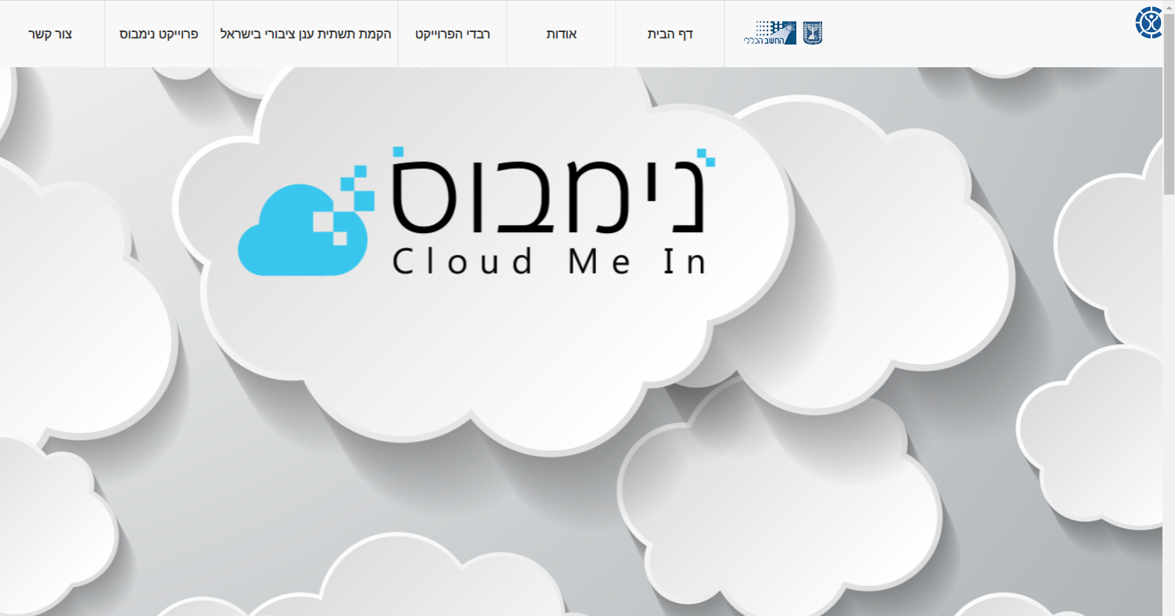
https://govextra.gov.il/nimbus-mr-gov-il/

Slide 77
מה זה פרויקט נימבוס?
"פרויקט נימבוס" הוא פרויקט דגל רב שנתי ורחב היקף, בהובלת מינהל הרכש הממשלתי באגף החשב הכללי במשרד אוצר יחד עם רשות התקשוב הממשלתי במשרד הדיגיטל הלאומי, הלשכה המשפטית במשרד האוצר, מערך הסייבר הלאומי, אגף תקציבים, משרד הביטחון וצה"ל.
"פרויקט נימבוס" נועד לתת התייחסות מקיפה ומעמיקה לאספקת שירותי ענן עבור ממשלת ישראל. הפרויקט צפוי לכלול מספר רבדים אשר ייתנו מענה הן ליצירת הערוץ לאספקת שירותי הענן בפועל והן לגיבוש מדיניות ממשלתית בנושא, הגירה לענן ומודרניזציה של שירותים וביצוע בקרה ואופטימיזציה על הפעילות בענן.

Slide 79
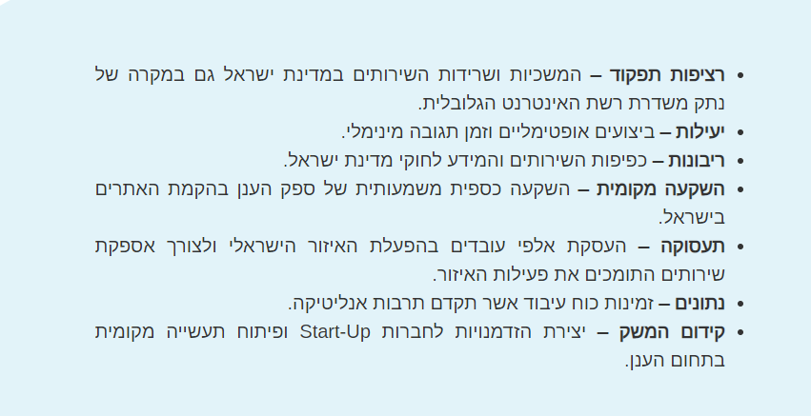
חשיבות ותועלות בהקמת תשתית ענן ציבורי בישראל

Slide 80
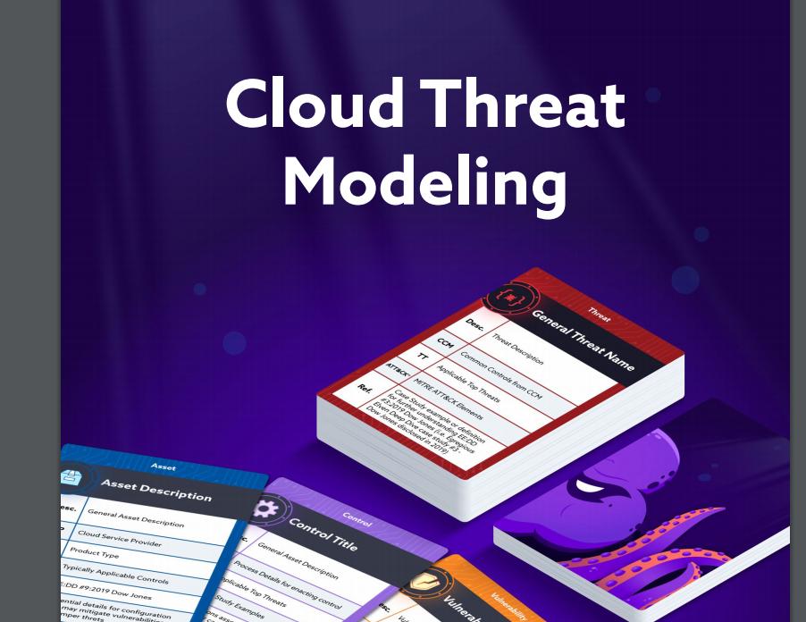
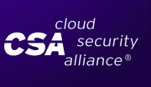

Slide 81
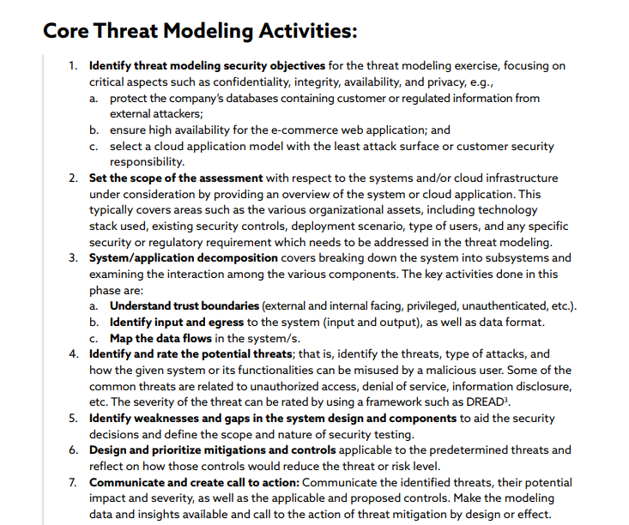

Slide 84
Google Cloud foundation design
https://services.google.com/fh/files/misc/google-cloud-security-foundations-guide.pdf

